Slide 1
OPERATION STORM
THE DECISIVE BATTLE OF THE CROATIAN WAR OF INDEPENDENCE
A primer on the ICTY Appeals Judgment that
proved Operation Storm was a
lawful military operation

Slide 2
This webinar is presented by:
Tomislav Z. Kuzmanovic
Trial Attorney for General Mladen Markac
Ana Katalinic
Case Manager for General Ante Gotovina

Slide 3
25th Anniversary of Operation Storm

Slide 4
THE ACCUSED
Ante Gotovina
Mladen Markac
Ivan Cermak

Slide 5
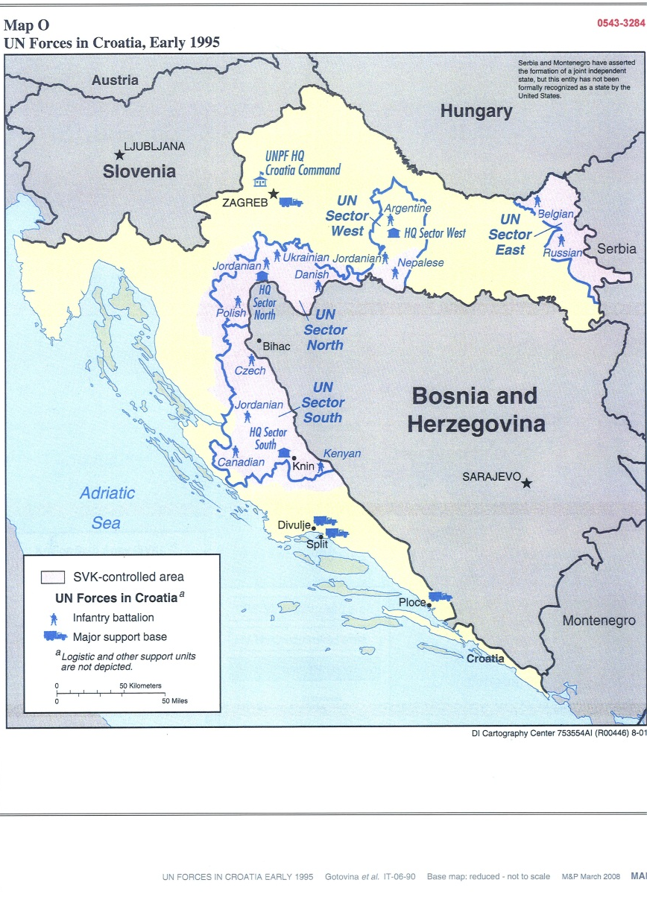
UN Forces in Croatia, Early 1995

Slide 6
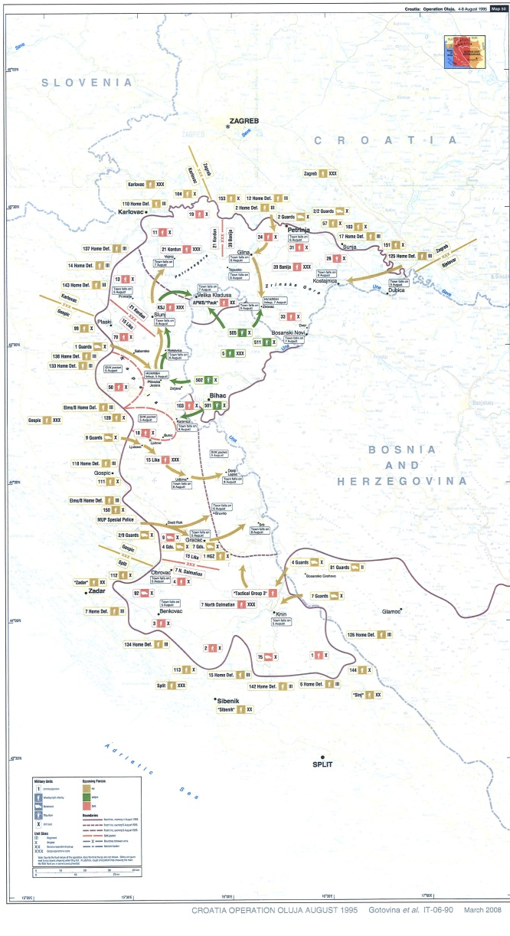
Croatia: Operation Oluja 1995

Slide 7
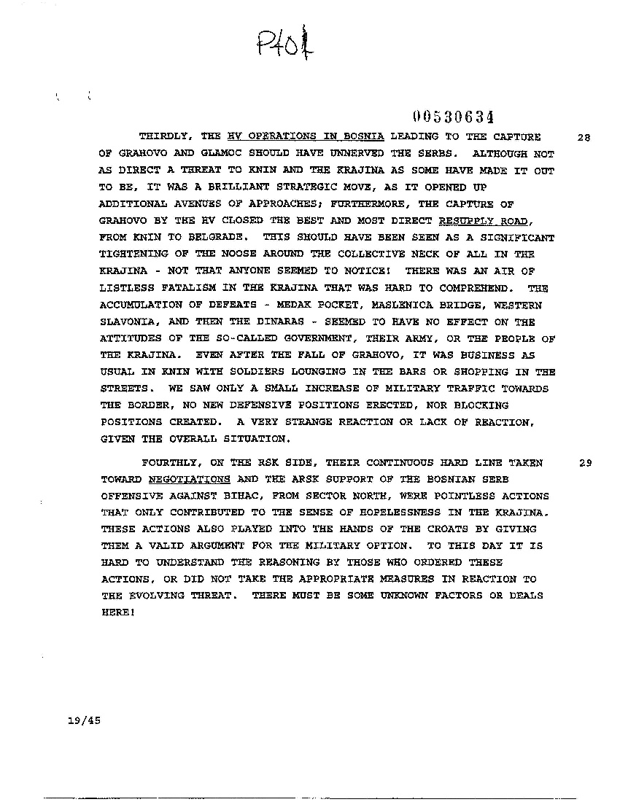
P401

Slide 8
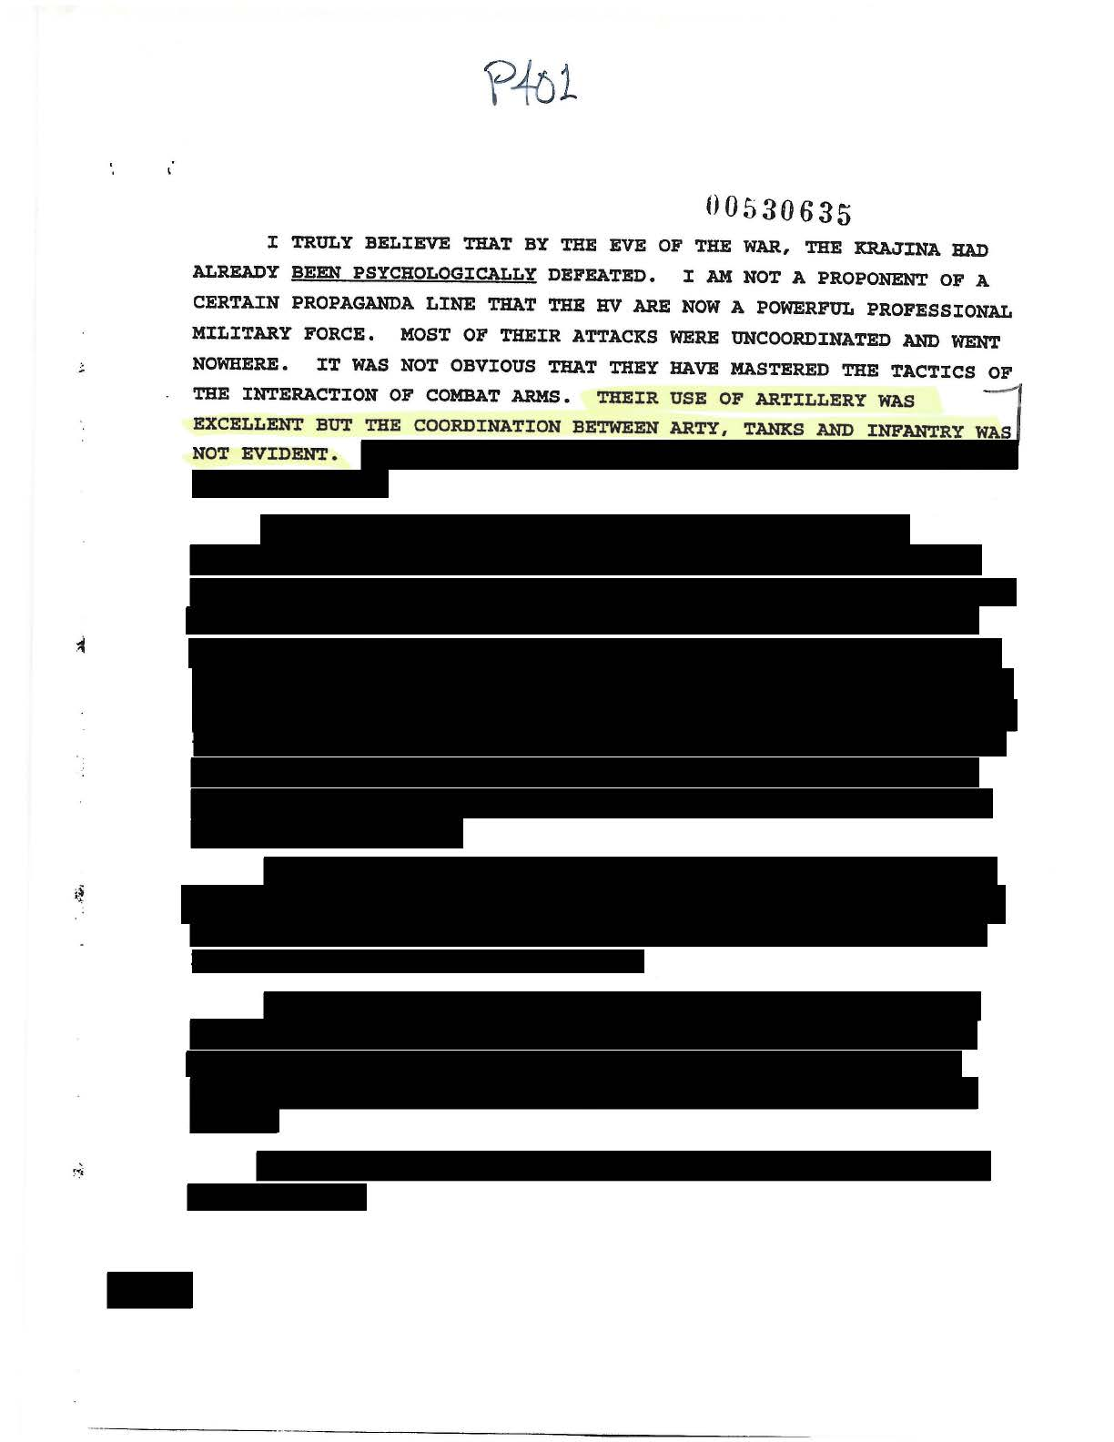
P401

Slide 9
P401

Slide 10
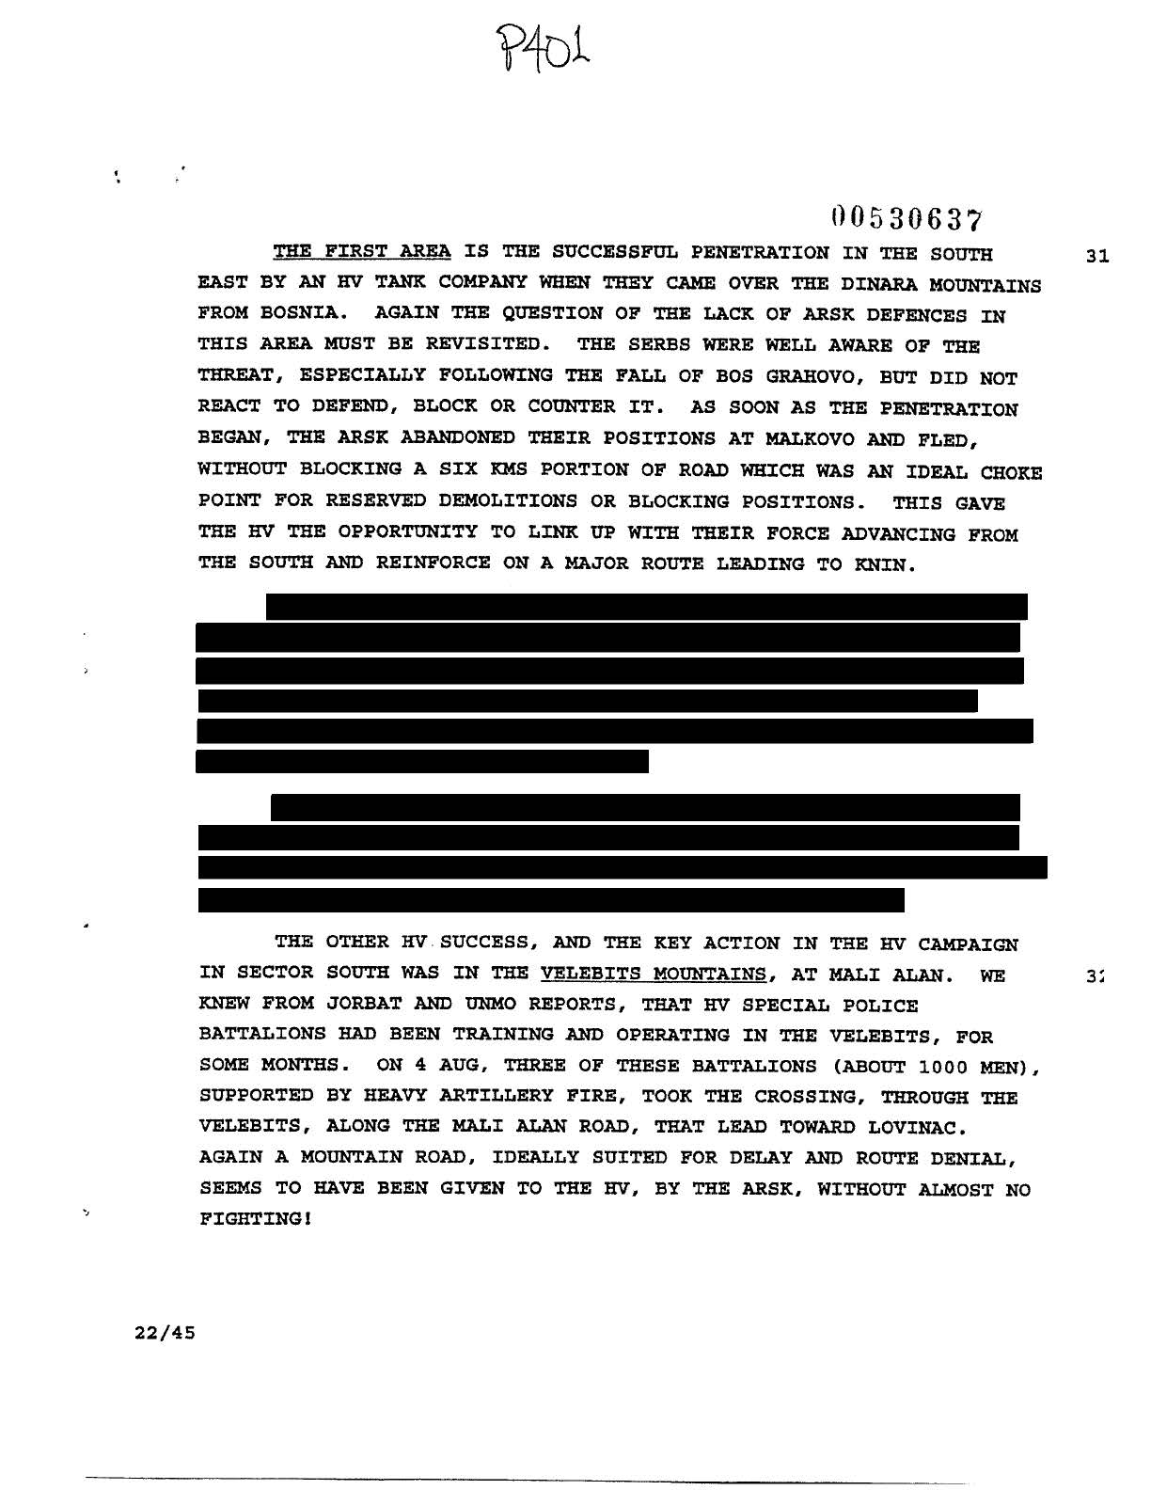
P401

Slide 11
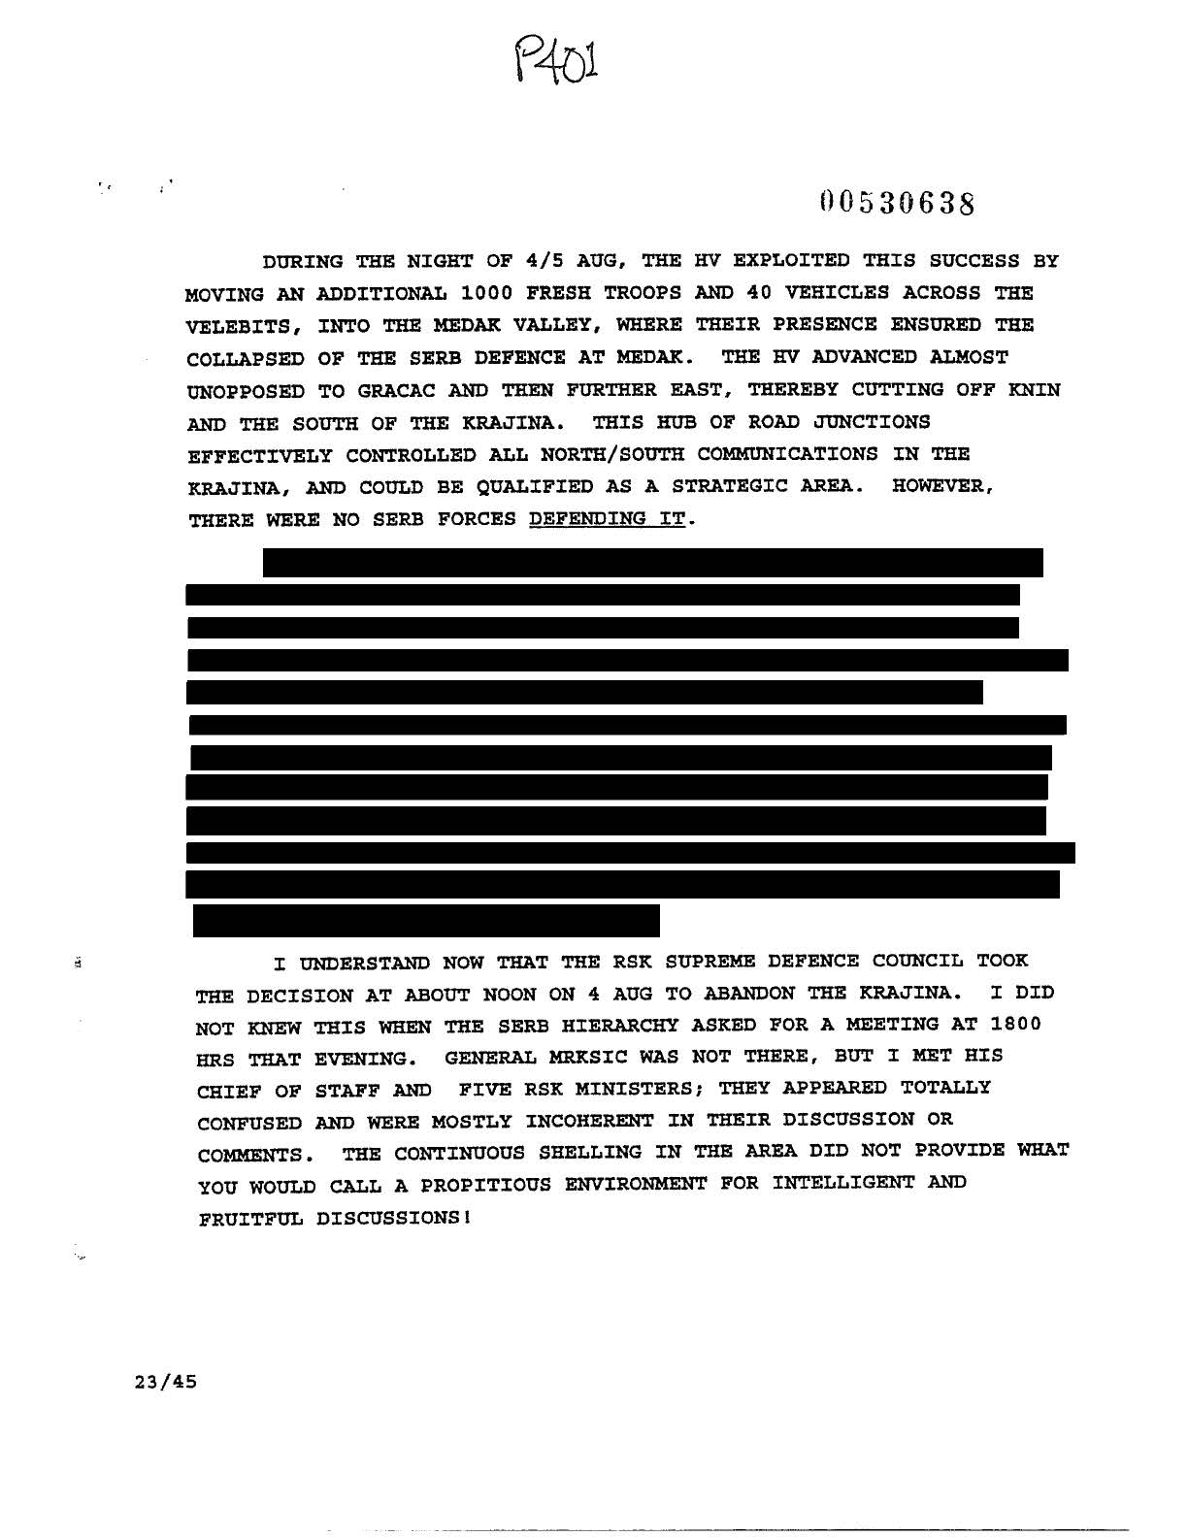
P401

Slide 12
CRITICS OF OPERATION STORM - WHAT THEY OFTEN FAIL TO MENTION
the atrocities committed by the rebel ARSK
that members of the RSK leadership were tried for war crimes by the ICTY
Milan Martic was sentenced 35 years
Milan Babic made a plea bargain and then killed himself because the remorse was consuming him
Goran Hadzic died before his trial ended
- the ethnic cleansing campaign in the RSK where virtually the entire non-Serb population was forcibly removed, deported or killed between 1991 and 1995.
- that the ICTY found that a JCE did exist in the RSK and that ethnic cleansing of non-Serbs occurred on a large scale

Slide 13
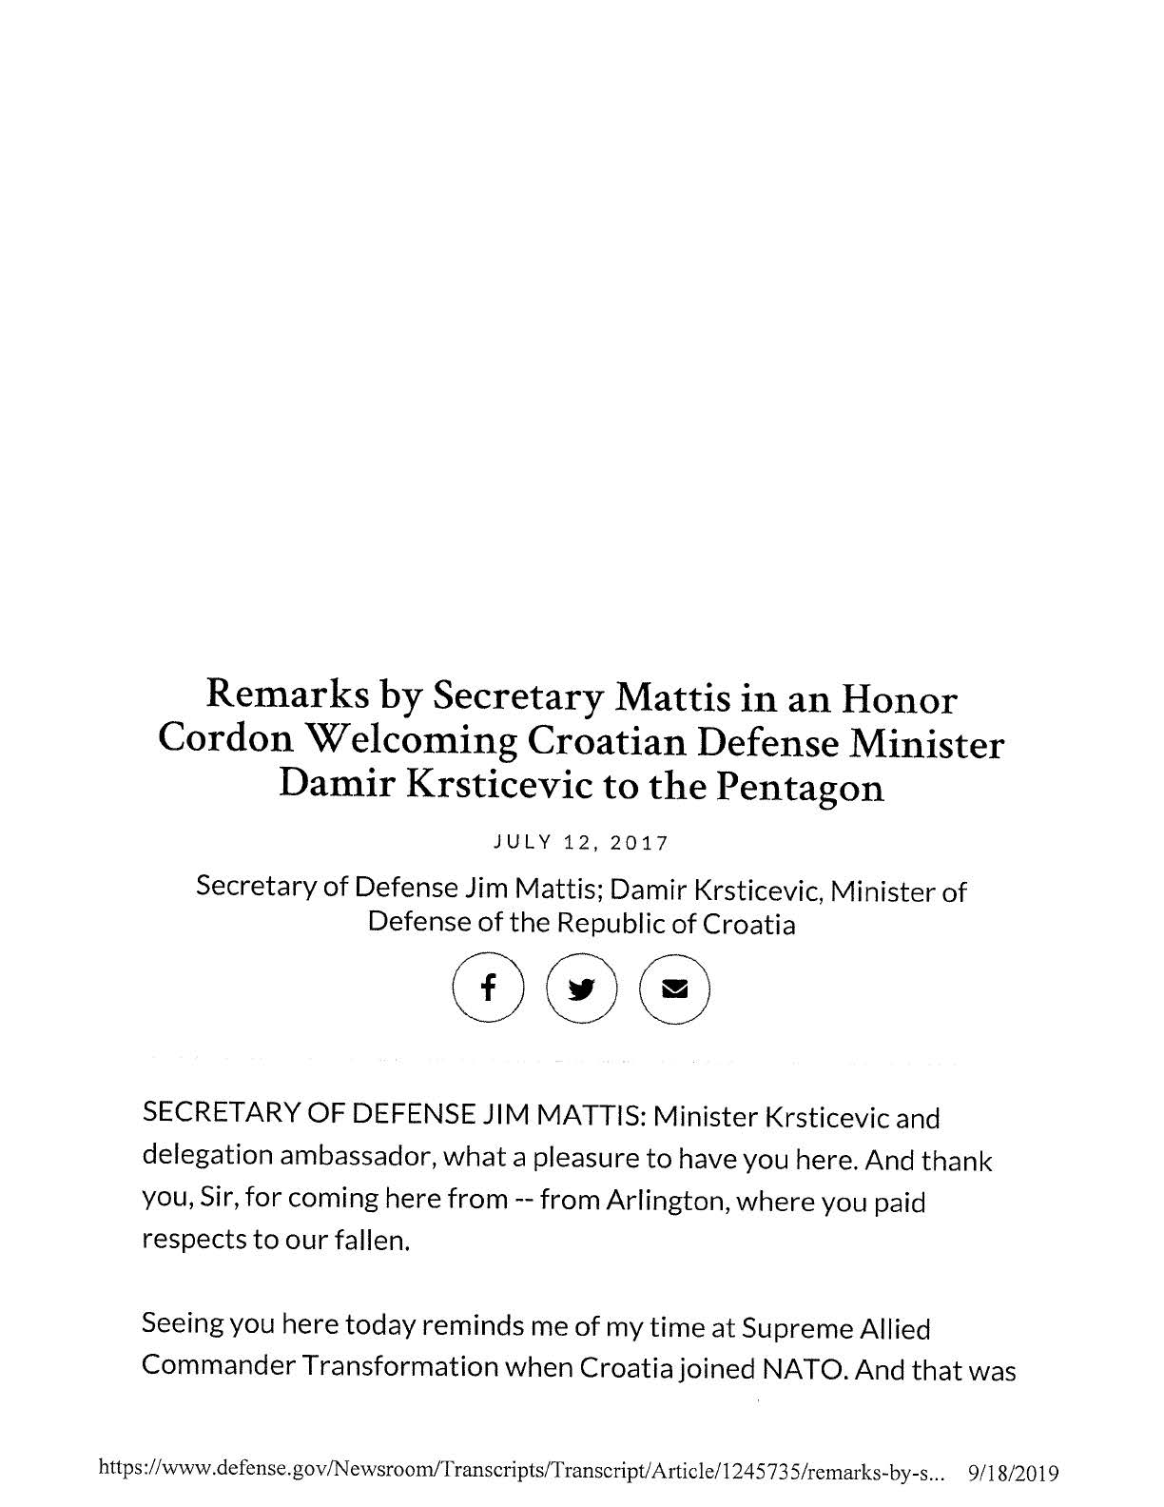
Remarks by Secretary Mattis in an Honor Cordon Welcoming Croatian Defense Minister Damir Krsticevic to the Pentagon

Slide 14
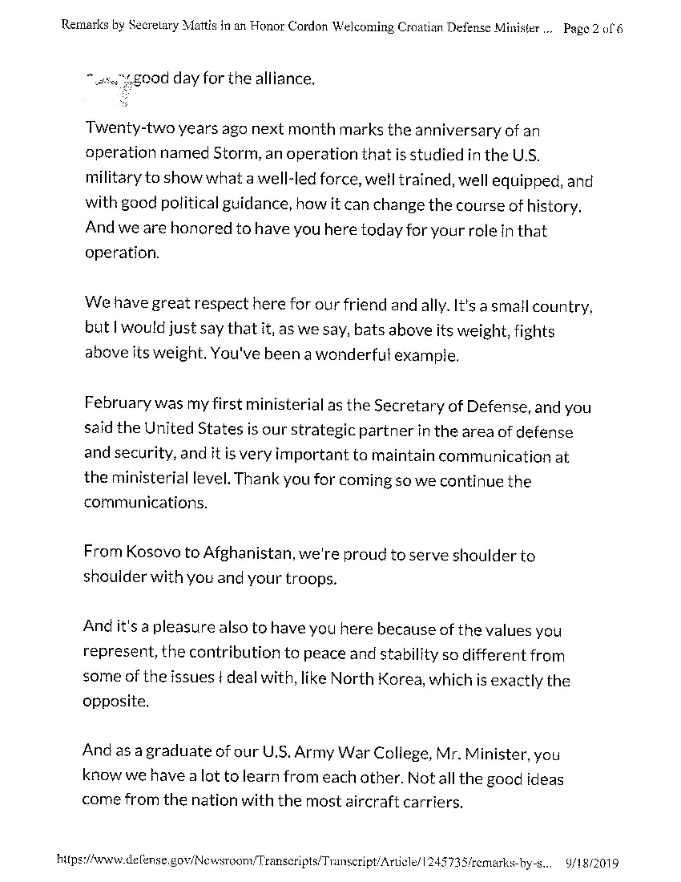
Remarks by Secretary Mattis in an Honor Cordon Welcoming Croatian Defense Minister Damir Krsticevic to the Pentagon

Slide 15
MILITARY EXPERTS NOW STUDY OPERATION STORM AS A LANDMARK CASE
… especially since the targeting decisions that occurred during Storm were so complex. The Trial Chamber decision was so poorly and unreasonably constructed that it prompted 12 military experts from across the world, on their collective initiative, to submit an application to the Appeals Chamber to become amicus curiae, friends of the court, for the sole purpose of offering the Appeals Chamber their insights as military and civilian IHL experts.
One of these 12 experts was actually a former Senior Legal Adviser in the ICTY's Office of the Prosecutor.
The Appeals Chamber didn't employ their insights. They didn't have to. It was clear as day that the Trial Chamber decision was gravely wrong.

Slide 16
TRIAL OF GENERALS GOTOVINA, CERMAK
AND MARKAC
The war in Croatia began in 1991 and ended in 1995. In that time period, in the area where the crimes alleged to have occurred, the Serbian military had virtually expelled the entire Croatian population of this area.
On August 4, 1995, the Croatian military launched a military operation called Operation Storm, which retook the occupied parts of Croatia. It is in this context that the indictment was brought.
The case concerned crimes allegedly committed from August 1995 to September 30, 1995 against the Krajina Serb population and property owned or occupied by Serbs in various municipalities of the Krajina region of Croatia.

Slide 17
TRIAL OF GENERALS GOTOVINA, CERMAK
AND MARKAC
Crimes Alleged:
According to the indictment, the accused were responsible for having planned, instigated, ordered, or aided or abetted the following crimes:
deportation and forcible transfer, plunder of public and private property, wanton destruction, murder, inhumane acts and cruel treatment.
persecution, including through unlawfully acts on civilians and civilian objects, unlawful detentions, and the imposition of restrictive and discriminatory measures.

Slide 18
SOME ELEMENTS TO CONSIDER REGARDING THE INDICTMENT
The indictment itself. Carla del Ponte, the Chief Prosecutor, wanted all sides to be “guilty”
2. The artillery attacks: the Prosecution wanted to establish proof of an evil plan - a JCE - that made the Serbs flee
3. The JCE was concocted by the Prosecution from a transcript of a meeting of the Croatian leadership at Brioni on July 31, 1995. According to the Prosecution, this was where the “evil plan” was masterminded.
4. The idea that Storm was a was a ‘war crime’ was first bellowed by Carl Bildt

Slide 19
TRIAL OF GENERALS GOTOVINA, CERMAK
AND MARKAC
The three accused were tried as alleged participants in a joint criminal enterprise, the objective of which was the permanent removal the Serb population from the Krajina region.
This enterprise involved the commission of crimes of persecution, deportation and forcible transfer, plunder and destruction. Alternatively, it was alleged that the crimes were a natural and foreseeable consequence of the execution of the enterprise. In addition, the crimes of murder, inhumane acts and cruel treatment were also alleged to be a natural and foreseeable consequence of the execution of the joint criminal enterprise.
The prosecution alleged that accused were criminally liable for having knowingly failed to prevent or punish criminal acts or admissions of their subordinates.

Slide 20
TRIAL OF GENERALS GOTOVINA, CERMAK
AND MARKAC
The case was heard over a period of more than three years. There were 303 trial days. All the parties including the Trial Chamber called witnesses during the different phases of the case.
145 witnesses were called to give evidence and the Chamber admitted written evidence of another 38 witnesses.
There were 4,825 admitted exhibits.

Slide 21
TRIAL OF GENERALS GOTOVINA, CERMAK
AND MARKAC
The Trial Chamber framed that judgment as a case about whether Serb civilians and their property were the targets of crimes and whether the accused should be criminally liable for these crimes.

Slide 22
TRIAL OF GENERALS GOTOVINA, CERMAK
AND MARKAC
General Gotovina and Markac were two of the many Croatian military and civilian leaders involved in Operation Storm.
Shortly after the military operation was over, General Cermak was named as the military garrison commander of Knin, the former capital of the Kranjina region of occupied Croatia territory.

Slide 23
WHAT DIDN’T OCCUR IN OPERATION STORM
-blatant indiscriminate attacks on civilian population centers (like what happened in Sarajevo)
-executions of assembled civilians (like what happened at Srebrenica)
-Croatia trying to conquer anyone else’s territory
-Operation Storm didn’t involve acts of ethnic cleansing
-the Croatian Army didn't deport or force the Serbs out of the Krajina. They left on their own will.

Slide 24
WHAT DID OCCUR IN OPERATION STORM
It was a complex military endeavour where the Croatian Army:
recaptured seized territory taken by rebel serbs four years earlier
targeted entrenched ARSK defensive positions
took strict measures to not harm Serb civilians or property
saved the Muslim population in the Bihac enclave in Bosnia Hercegovina from the fate that Srebrenica suffered only weeks earlier

Slide 25
TRIAL OF GENERALS GOTOVINA, CERMAK
AND MARKAC
All three accused were charged as participants in the joint criminal enterprise.
In assessing whether there was a joint criminal enterprise, the Trial Chamber considered discussions at a meeting of Croatian Leadership on July 31, 1995, a few days before the launching of Operation Storm. At this meeting, Croatian President Tudjman met with high ranking military and civilian officials to discuss the military operation.
The Chamber considered statements in the context of this meeting as a sharing of the common objective of the permanent removal of the Serb civilian population from the Krajina by force or threat of force, which amounted to deportation, forcible transfer, persecution through the imposition of restrictive and discriminatory measures, unlawful acts against civilians and civilian objects, deportation and forcible transfer.

Slide 26
TRIAL OF GENERALS GOTOVINA, CERMAK
AND MARKAC
However, the Chamber found that the common objective did not amount to or involve the commission of the crimes and the persecution, wanton and destruction, plunder, murder, inhumane acts, cruel treatment and unlawful detention.
The base JCE allegation being attributed to the accused were that the two generals who had ordered the artillery attack at the beginning of the operation ordered an unlawful attack on civilians and civilian objects. Moreover, the generals were alleged to have made an effort to prevent the follow-up on crimes reported to have been committed by subordinates and that the other charged crimes, although not part of the common purpose, were natural and foreseeable consequences of the execution of the joint criminal enterprise and foreseeable for two of the three generals.

Slide 27
TRIAL OF GENERALS GOTOVINA, CERMAK
AND MARKAC
General Cermak was found not to be a member of the joint criminal enterprise or having made any intentional or significant contribution to it (he was not at the leadership meeting on July 31, 1995).

Slide 28
TRIAL OF GENERALS GOTOVINA, CERMAK
AND MARKAC
Gotovina was sentenced to 24 years;
Markac 18 years; and
Cermak released.

Slide 29
HOW DID THE TRIAL CHAMBER FIND THE CROATIAN ARMY GUILTY OF UNLAWFUL ARTILLERY ATTACKS?

Slide 30
TARGETS….
Let’s first look at targets. A proper military commander:
identifies enemy military positions
sets the conditions for achieving his tactical, operational, and strategic objectives
assesses potential enemy targets and
executes them in accordance with IHL.
This is exactly what the Croatian Army did, under the leadership of General Gotovina. Only places and objects that qualified as lawful military objectives were attacked in Operation Storm.

Slide 31
200-METRE RADIUS OF ERROR AND AN IMPACT ANALYSIS. (or… how to fortify a dying claim of a JCE)
This point was one of the dominoes of the Trial Chamber judgment that collapsed on appeal. This is the 200-metre rule summarized. It’s pretty simple
- projectiles that impacted within a distance of 200 meters of an identified artillery target were ok and presumed to have been fired at that target
- projectiles that hit beyond 200 metres of the target were automatically considered by the Trial Chamber as an unlawful attack on civilians
The Appeals Chamber quite easily found that the 200m rule was baseless. There was nothing …. no support, no testimony, no exhibit, no mention in an expert report, of any 200-metre standard.

Slide 32
200-METRE PRECISION STANDARD - AN ALARMING ELEMENT OF THE TRIAL CHAMBER’S JUDGMENT
Gotovina appealed this rationale which was an alarming element of the Trial Chamber's judgment.
The argument was that it is essentially impossible to expect military commanders to adhere to a 200 metre precision standard.
The closest reasonable standard that was found on the trial record was through the testimony of Andrew Leslie, who stated that a 400m error radius was an acceptable standard.

Slide 33
The Trial Chamber’s finding of unlawful artillery attacks was mostly based on their analysis of the impact sites within the Four Towns. These Impact Analyses were directly linked to, and relied on, this 200-metre standard.
- Their analyses concluded, no surprise, that all impact sites more than 200 metres from its intended target were evidence of unlawful artillery attack.
- The Trial Chamber then concluded that the unlawful attacks were the cause of the deportation of Serb civilians from the Krajina.
- The Appeals Chamber determined that the Trial Chamber’s errors with respect to the 200 Metre Standard and targets of opportunity were sufficiently serious that the conclusions of the Impact Analysis could not be sustained”

Slide 34
PRINCIPLES OF INTERNATIONAL HUMANITARIAN LAW - AS THEY APPLY HERE
1. What was the commander’s state of mind at the time he ordered the attack?
The Trial Chamber interpreted Gotovina’s statements at the Brioni meeting as proof that he was going to drive the Serbs out
The Appeals Chamber, however, said that the Trial Chamber made inferences from the Brioni meeting alongside the Trial Chamber’s own finding of unlawful artillery attacks and ONLY THEN established the existence of a JCE.
…/2

Slide 35
PRINCIPLES OF INTERNATIONAL HUMANITARIAN LAW - AS THEY APPLY HERE
2. Were acts of violence wilfully directed against the civilian population?
The Appeals Chamber determined that, since there was no finding of unlawful artillery attacks, then no allegation of crimes of deportation, forcible transfer or related persecution could be sustained since nothing illegal happened to make the civilians leave

Slide 36
APPEAL
There are several reasons why the Trial Chamber’s judgment was severely flawed.
It found liability on JCE 3 which is the most contentious and tenuous form of JCE.
The key factor for the JCE decision, however, was the Trial Chamber’s acceptance of the prosecution’s theory that the planning meeting on July 31 constituted a plan to expel the Serb population by directly attacking civilians with artillery causing them to flee.
This was accomplished allegedly by firing artillery on several of the larger towns, including Knin, the center of gravity of the Krajina occupation.

Slide 37
APPEAL
The Trial Chamber found that there were many legitimate targets in the towns and the Croatia military fired at least 95% of its artillery rounds against legitimate military objectives.
The Trial Chamber was unable to identify any civilian victims of shelling anywhere in this whole military operation.
The Trial Chamber did reject prosecution’s argument that the alleged members of JCE intended to allow crimes to take place against Serb civilians and property.

Slide 38
APPEAL
The Trial Chamber convicted Generals Gotovina and Markac because it found that the remaining 5% artillery rounds (approximately 65 out 1200 rounds) fell too far (i.e. more than 200 meters) from known military objectives.
According to the Trial Chamber, this 5% was the “primary and direct cause” of the departure of Serb civilians, even though the Trial Chamber could not identify any Serb civilian who was killed or injured by shelling or who claimed to have left Croatia out of fear of shelling.
Other than its specific reference to four of the larger towns in the area of Operation Storm, the Trial Chamber found that Serb civilians left for reasons unrelated to unlawful conduct by the Croatian military.

Slide 39
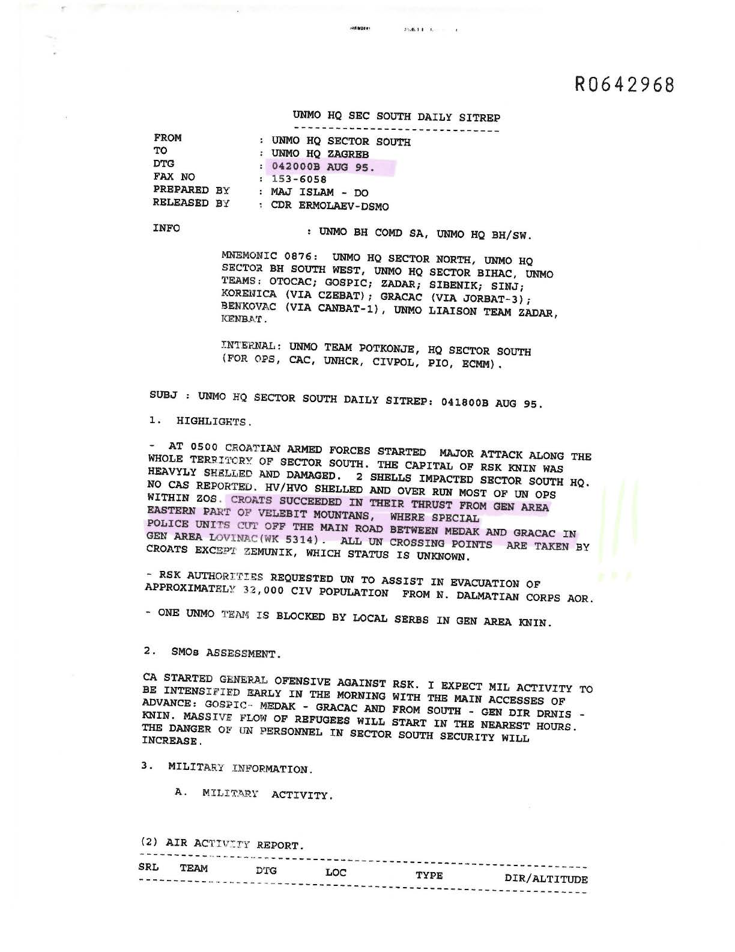
UNMO HQ Sec South Daily Sitrep

Slide 40
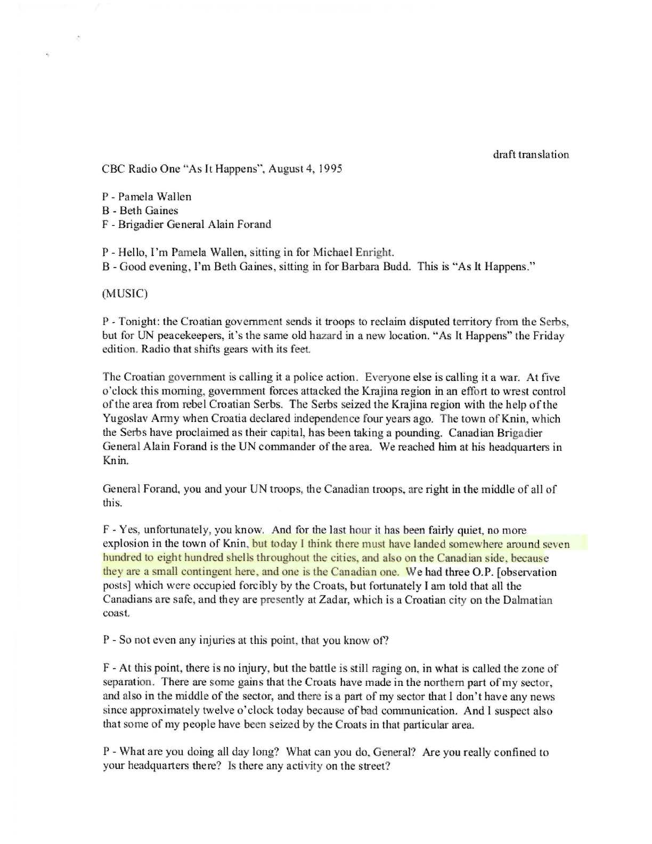
As It Happens

Slide 41
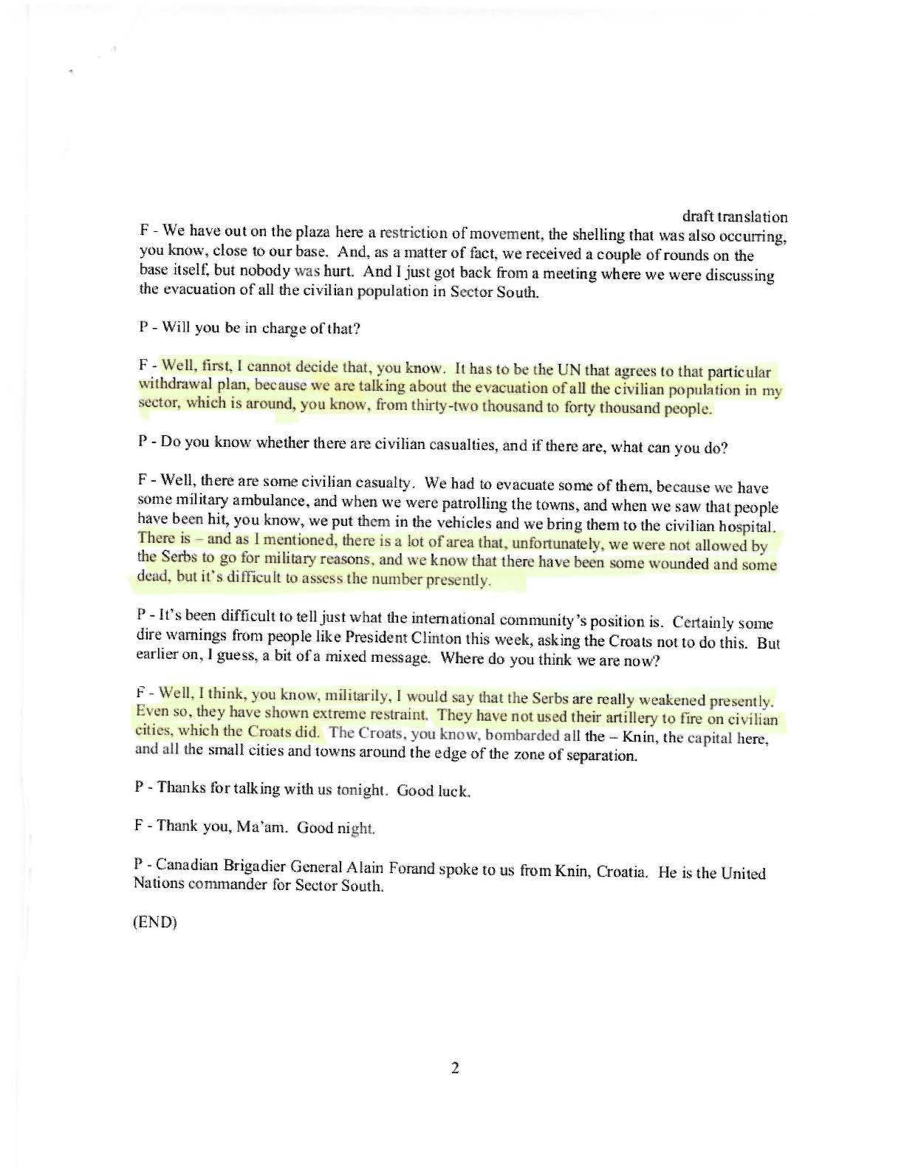
As It Happens

Slide 42
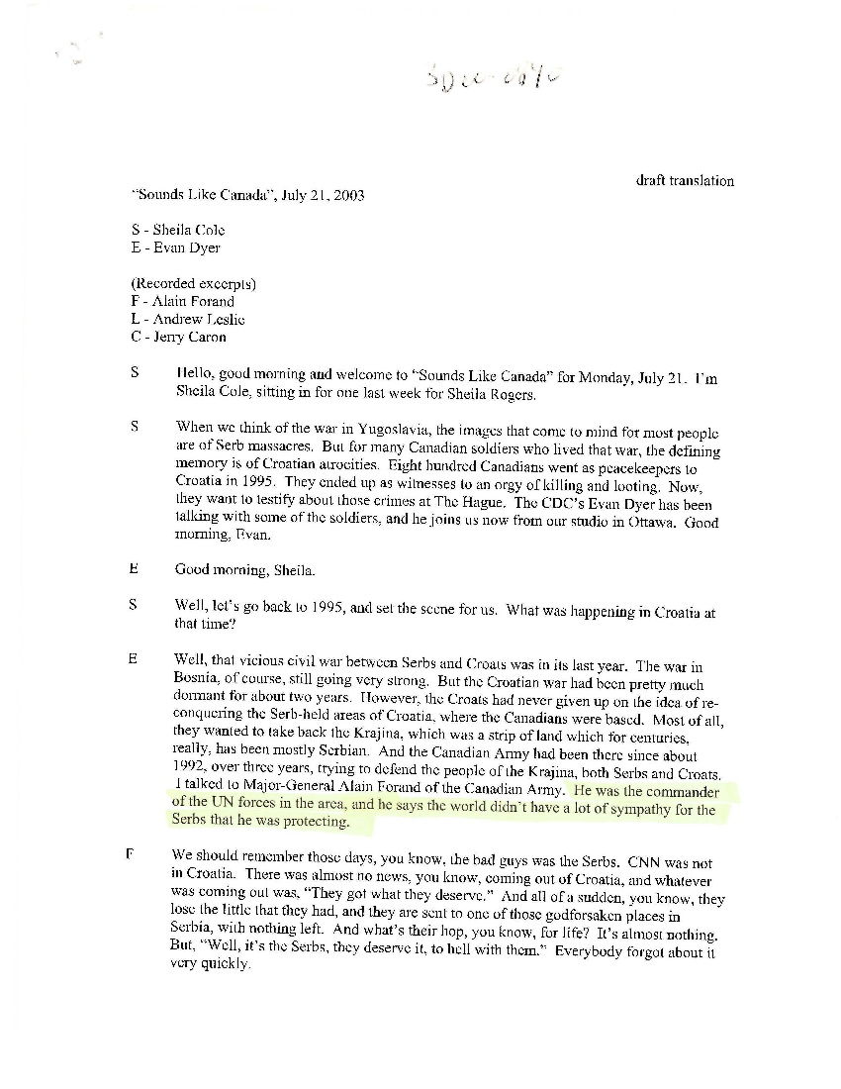
Sounds Like Canada

Slide 43
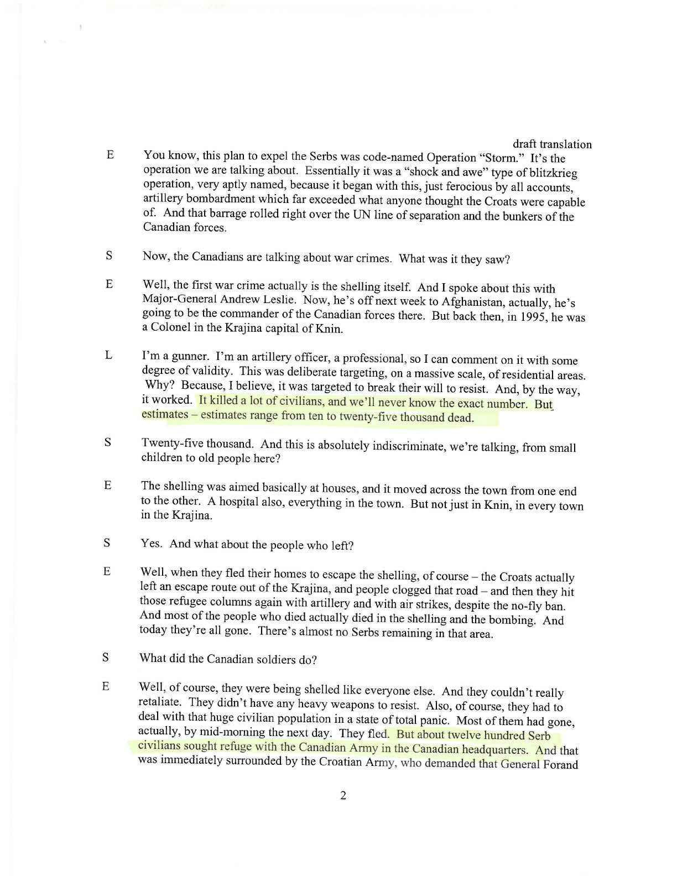
Sounds Like Canada

Slide 44
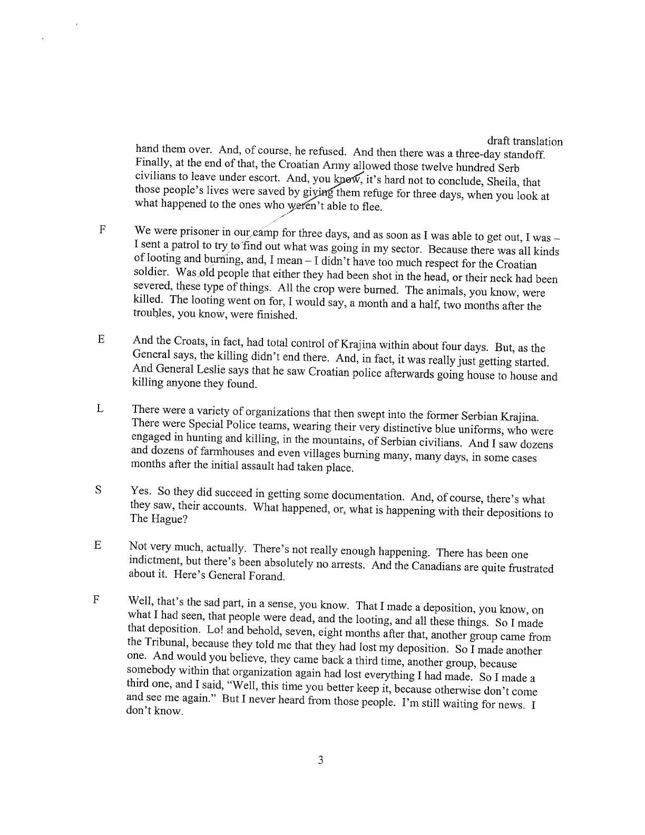
Sounds Like Canada

Slide 45
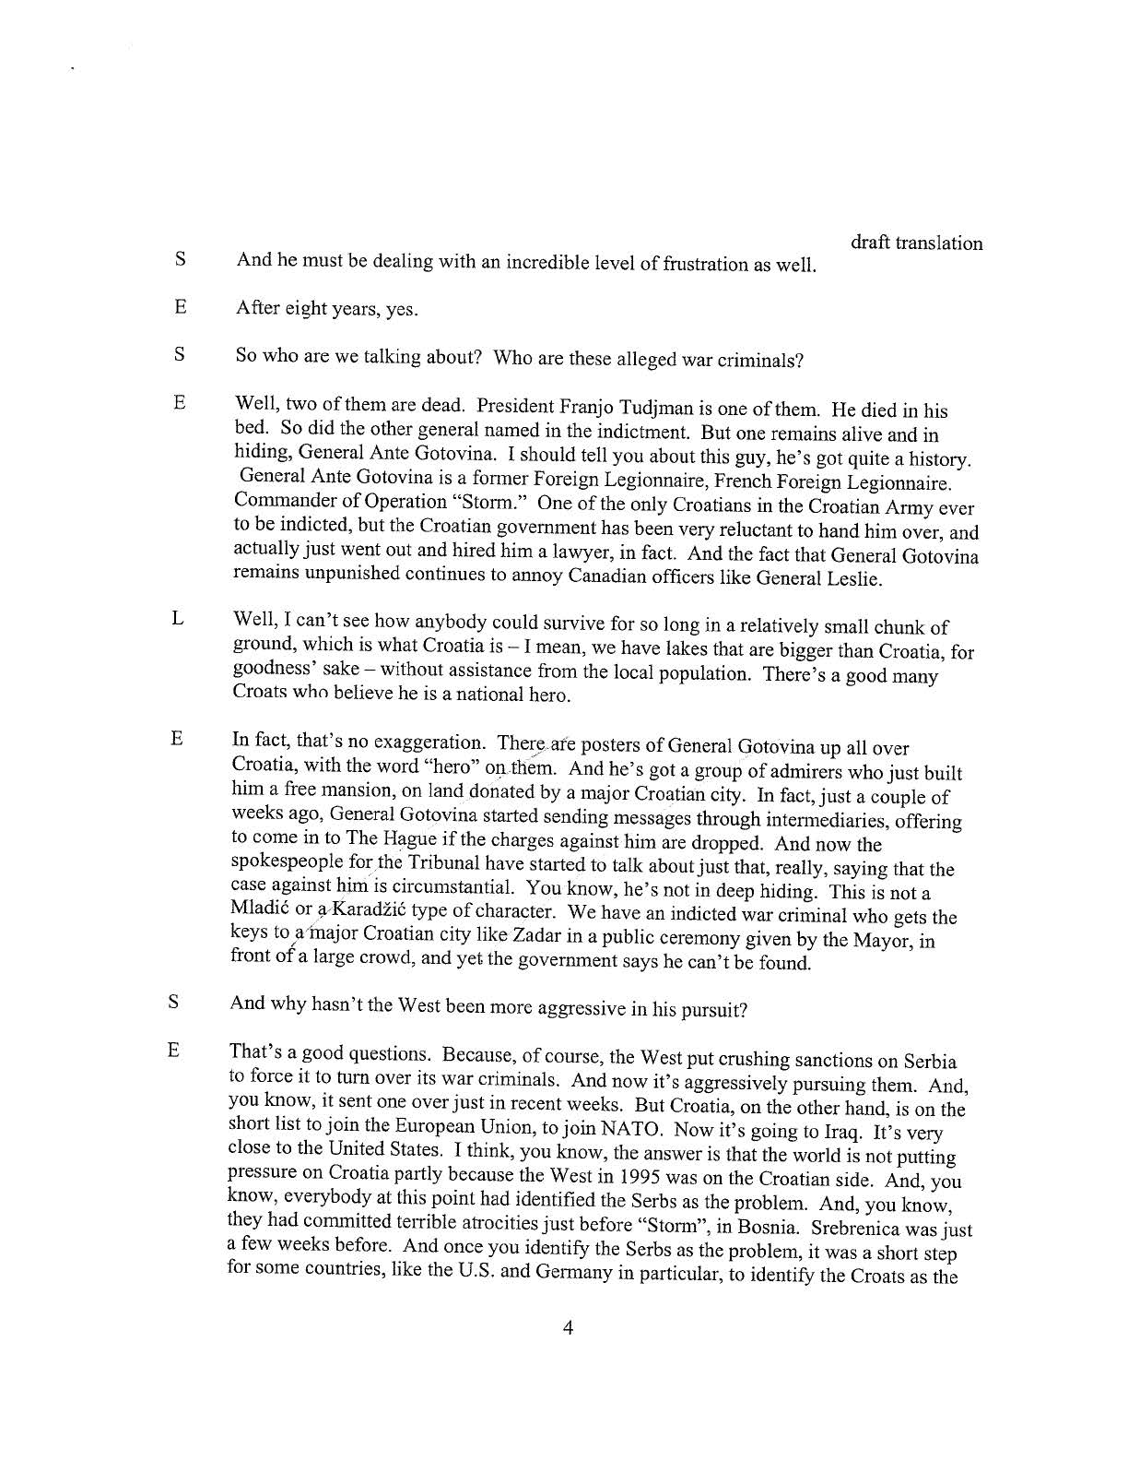
Sounds Like Canada

Slide 46
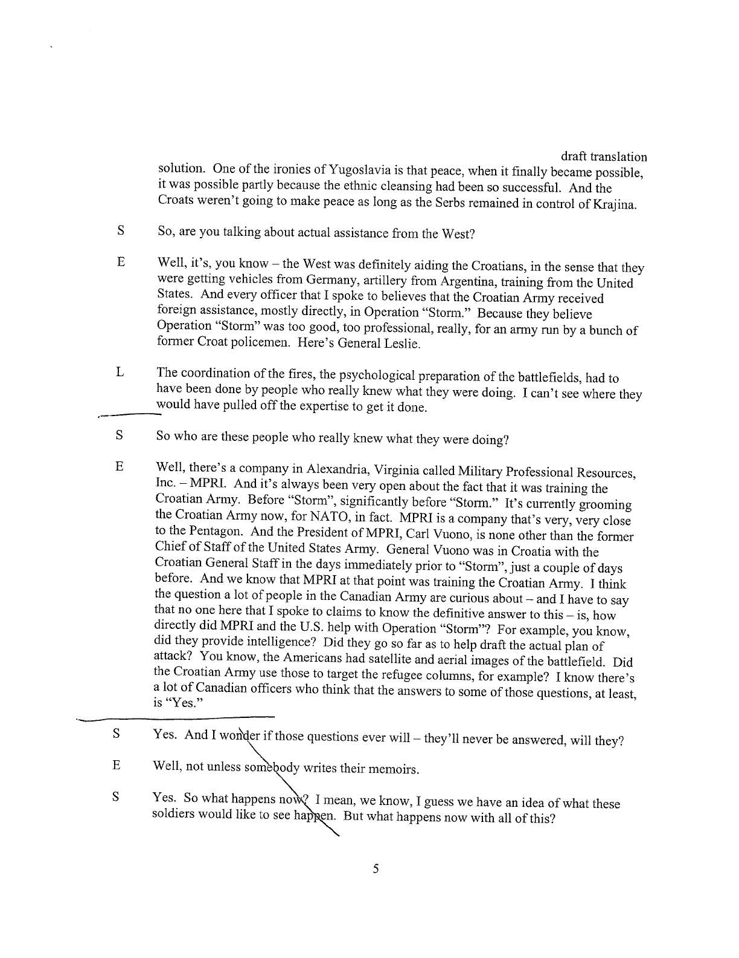
Sounds Like Canada

Slide 47
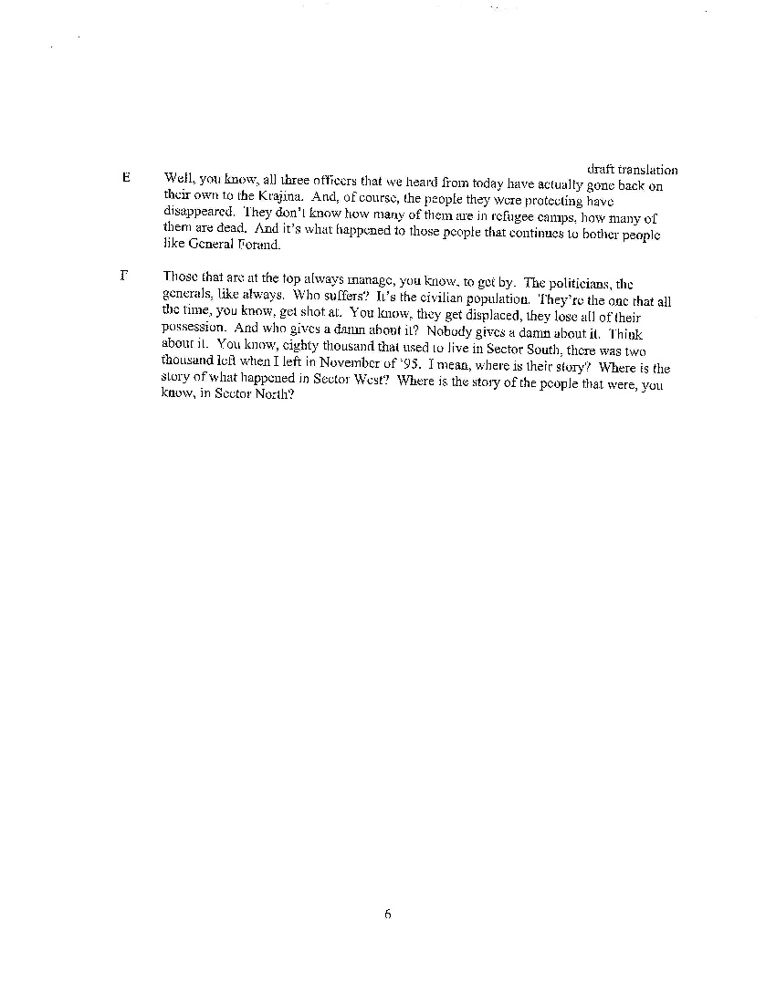
Sounds Like Canada

Slide 48
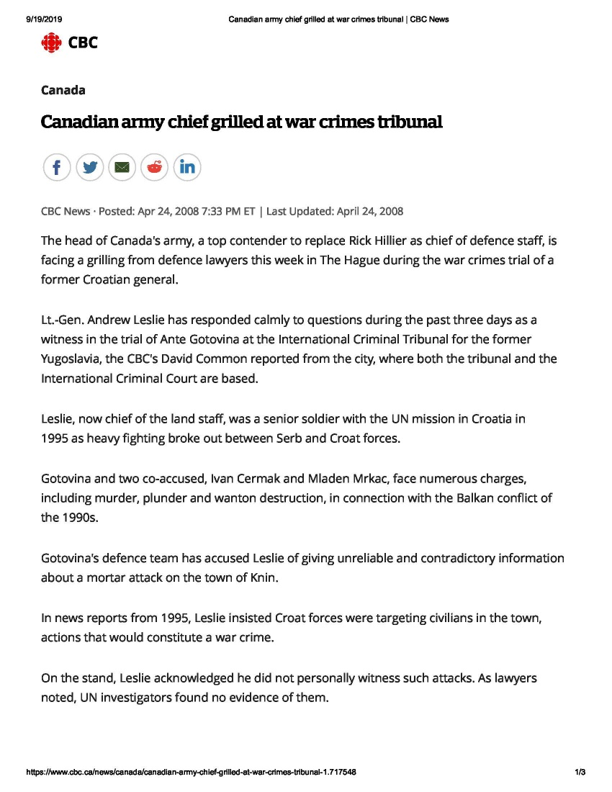
Canadian Army Chief Grilled at War Crimes Tribunal

Slide 49
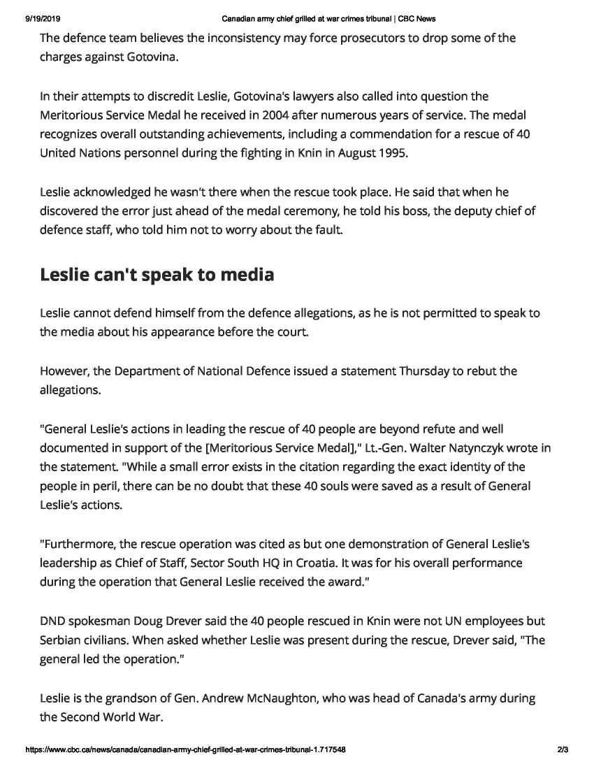
Canadian Army Chief Grilled at War Crimes Tribunal

Slide 50
APPEAL
The Trial Chamber based its conviction of the Generals Gotovina and Markac for crimes such as murder, burning, and looting committed after Operation Storm, not because they had intended those crimes to take place, but because those crimes were allegedly “a foreseeable consequence” of the unlawful artillery attack;
Therefore under the doctrine of JCE they were liable for those crimes even if they actively opposed their commission.

Slide 51
APPEAL
The Trial Chamber did not find Generals Gotovina or Markac liable under superior authority/command responsibility doctrine.

Slide 52
DID GENERAL GOTOVINA ORDER AN UNLAWFUL ATTACK?
Trial Chamber fixated itself on Gotovina’s August 2 1995 order (Exh P1125) stating that he ordered an unlawful attack to shell the entire Four Towns indiscriminately
Gotovina argued that the attacks were meant against military targets only. The Appeals Chamber agreed, saying that the order did not explicitly call for unlawful attacks on the Four Towns
The Appeals Chamber went on to state that the Trial Chamber made conclusions of unlawful artillery attacks by viewing other evidence on record through the prism of their Impact Analyses.

Slide 53
APPEALS JUDGMENT
Appeals chamber in a 3 to 2 decision acquitted Generals Gotovina and Markac of all charges
There was no JCE that either participated in or that existed among Croatian governmental and military officials.

Slide 54
APPEALS JUDGMENT
One of the popular criticisms of the Gotovina Judgement is that the Appeals Chamber did not consider the “totality of the evidence” in assessing the culpability of Gotovina and Markac, but instead focused too narrowly on the 200 Meter Standard.

Slide 55
APPEALS JUDGMENT
Any fair assessment of the “totality of the evidence” leads to the following inescapable conclusions: There was no JCE, and the convictions of Gotovina and Markac by the Trial Chamber was one of the biggest scandals in the history of international criminal law.

Slide 56
APPEALS JUDGMENT
The Prosecution, the Defense, the Trial Chamber and the Appeals Chamber (including Judges Pocar and Agius) all unanimously agree on the following “totality of the evidence”:

Slide 57
APPEALS JUDGMENT
1. The Prosecution could not produce any evidence of the identity of a single civilian victim of shelling by Gotovina’s forces. The evidence in the trial record did not provide a single scrap of evidence that identified any civilian who was killed or even injured by shelling, anywhere in the so-called “Krajina.”

Slide 58
APPEALS JUDGMENT
2. The Prosecution could not produce any evidence of the identity of a single Serbian civilian who claimed to have fled Croatia due to fear of shelling. Thus, while the Trial Chamber (wrongly) concluded that at least 20,000 Serb civilians fled Croatia from the four towns of Knin, Benkovac, Obrovac and Gracac due to fear of shelling, not a single one of these 20,000 has ever been identified.

Slide 59
APPEALS JUDGMENT
3. The United Nations conducted an investigation into the shelling of Knin immediately after Operation Storm. On 18 August 1995, the United Nations concluded that the shelling “was concentrated against military objectives,” and that “only few impacts (3-5) is observed in other urban areas.”

Slide 60
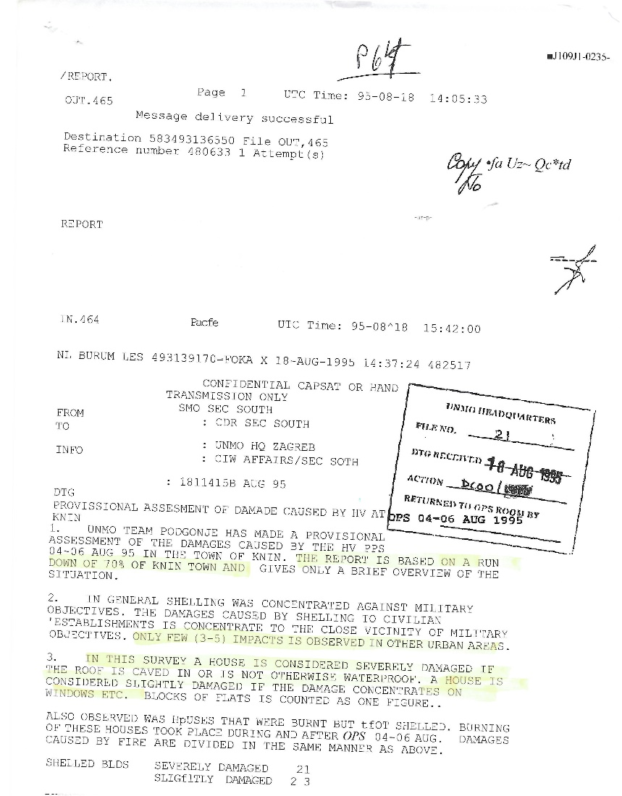
P64

Slide 61
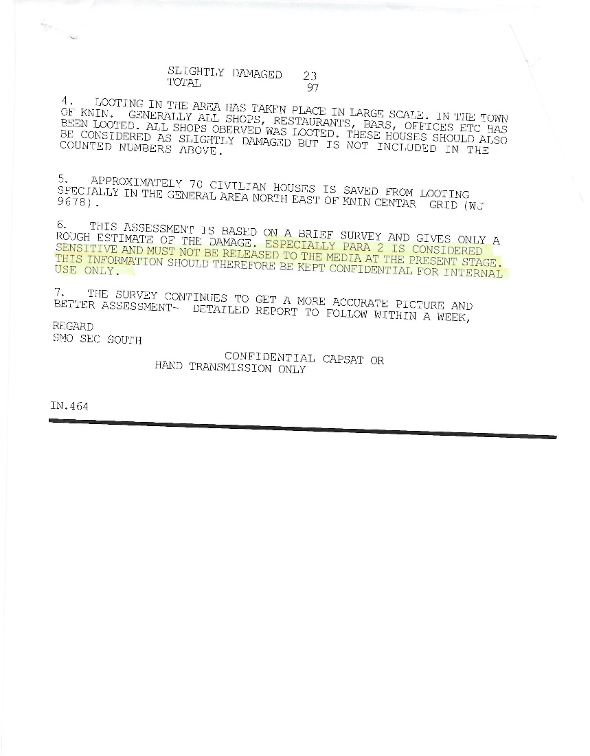
P64

Slide 62
APPEALS JUDGMENT
4. Both the Trial Chamber and Appeals Chamber unanimously agree that in all areas of the “Krajina” except Knin, Benkovac, Obrovac and Gracac, the “Krajina” Serbs left for their own reasons, unrelated to any unlawful conduct by Croatian forces. According to the Trial Chamber, these reasons included:

Slide 63
APPEALS JUDGMENT
Krajina” Serb officials telling inhabitants to leave the areas (Trial Judgement, paragraph 1762);
Fear of violence commonly associated with armed conflict (Trial Judgement, paragraph 1762);
General fears of Croatian forces and a distrust of Croatian authorities (Trial Judgement, paragraph 1762); and

Slide 64
APPEALS JUDGMENT
The fact that other Serbs were departing caused some to leave (Trial Judgement, paragraphs 1754, 1762).

Slide 65
APPEALS JUDGMENT
Even though there are no victims of shelling in the four towns, and even though not a single Serb civilian was ever identified as having left Croatia from the four towns due to fear of shelling, Judges Pocar and Agius argue that “no reasonable trier of fact could conclude any differently” than that the Serbs from these four towns were expelled by artillery fire.

Slide 66
Acquittals should not eliminate JCE?
Judge Pocar argued that even if the Appeals Chamber were to acquit Gotovina and Markac, it should have established that a JCE existed involving three deceased individuals: Croatian President Franjo Tudjman, Minister of Defence Gojko Susak, and Croatian Army Chief of Staff Zvonimir Cervenko.

Slide 67
The Majority Correctly Applied the Standard of Review
All five judges of the Appeals Chamber unanimously agreed that the Trial Chamber erred in establishing a 200 Meter Standard. The Trial Chamber made an error of fact in establishing the 200 Meter Standard because it was “not linked to any evidence.”

Slide 68
The Majority Correctly Applied the Standard of Review
Judge Pocar also agreed with the Majority that the 200 Meter Standard amounts to an error of law because the Trial Chamber failed to provide a reasoned opinion in writing, in violation of Article 23 of the Tribunal’s Statute.

Slide 69
The Majority Correctly Applied the Standard of Review
Because the Trial Chamber failed to provide a reasoned opinion on a key element of the offences of persecution and deportation (i.e. whether there was an unlawful attack against civilians and civilian objects), the Majority decided that it would “consider de novo the remaining evidence in the record to determine whether the conclusions of the impact analysis are still valid."

Slide 70
The Majority Correctly Applied the Standard of Review
Once it was established that the Trial Chamber had failed to render a reasoned opinion concerning the 200 Meter Standard, the Appeals Chamber reviewed the Trial Chamber’s factual findings and relevant evidence on the record to determine whether a reasonable trier of fact could have found beyond reasonable doubt that Gotovina and Markac had launched an unlawful artillery attack against civilians and civilian objects.

Slide 71
Severe Restrictions on Use of Military Operations, Particularly in Civilian Populated Areas with Legitimate Military Targets, Reversed
The Trial Chamber's conclusion that any round from any artillery piece that landed outside a 200 meter radius from a legitimate pre-determined military target was presumed to be indiscriminately aimed at civilian targets was unreasonable.
This rule would have exposed to criminal prosecution untold numbers of combat military officers who did no more than follow indirect fire doctrine that has been universally accepted for decades both within the United States and throughout the world.

Slide 72
Croatia Reaction To Decision
https://www.youtube.com/watch?v=ZxNLxHibSgs&index=8&list=FL9zpjdoDPhe6h2T9ZENeIng

Slide 73
Return to Croatia
https://www.youtube.com/watch?v=L5NBJpt1pug&index=10&list=FL9zpjdoDPhe6h2T9ZENeIng

Slide 74
REMEMBERING THE TRIAL

Slide 75
REMEMBERING THE TRIAL

Slide 76
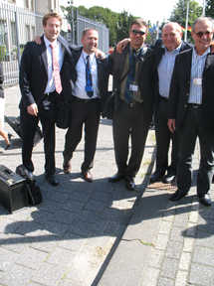
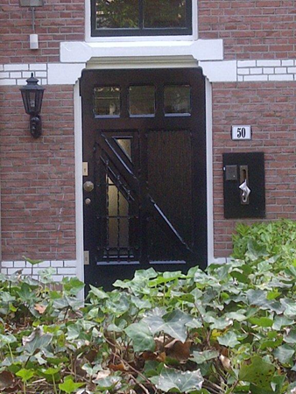
REMEMBERING THE TRIAL

Slide 77
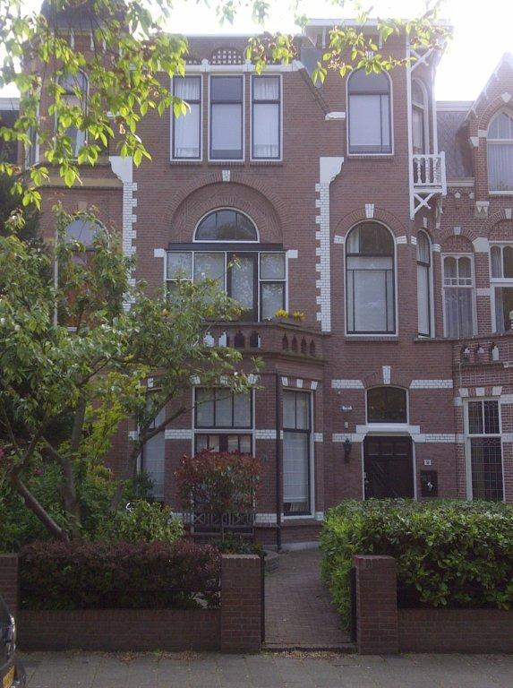
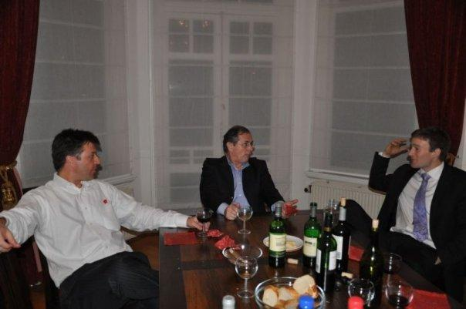
REMEMBERING THE TRIAL

Slide 78
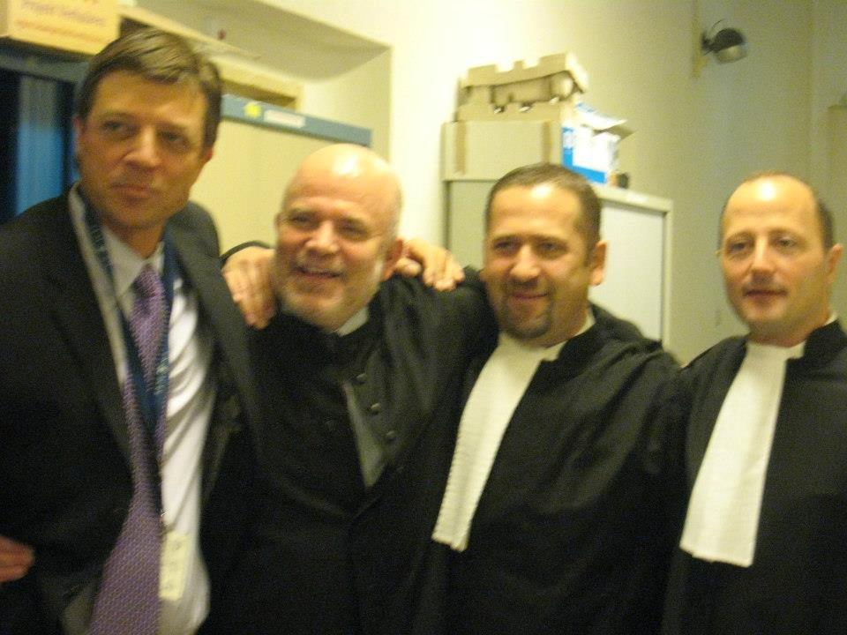
Victory

Slide 79
GENERAL GOTOVINA’S FIRST MORNING IN ZAGREB

Slide 80
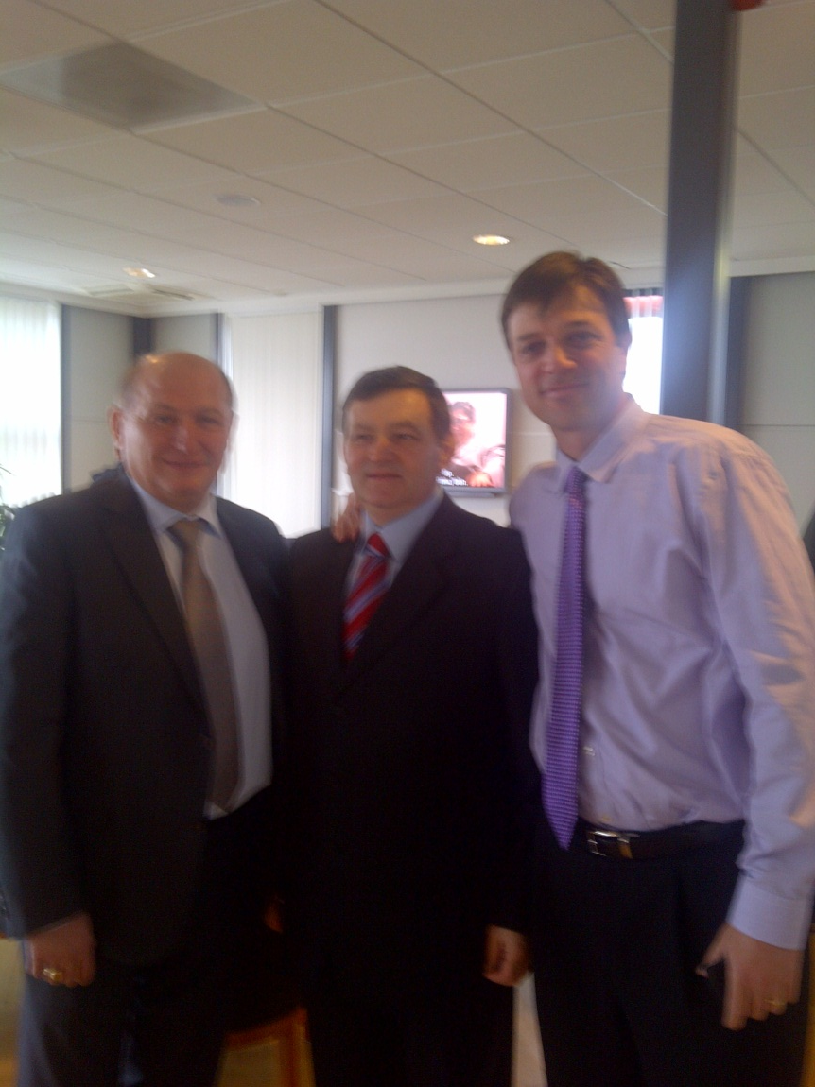
FREEDOM

Slide 81
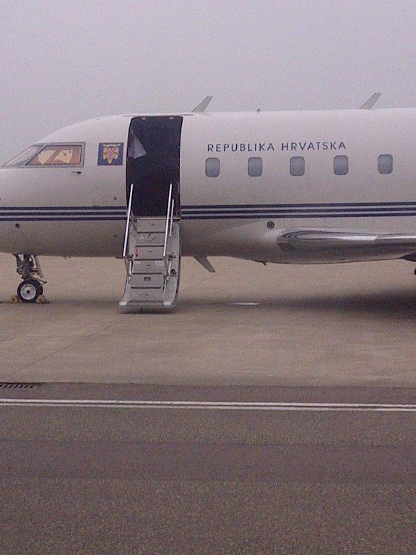
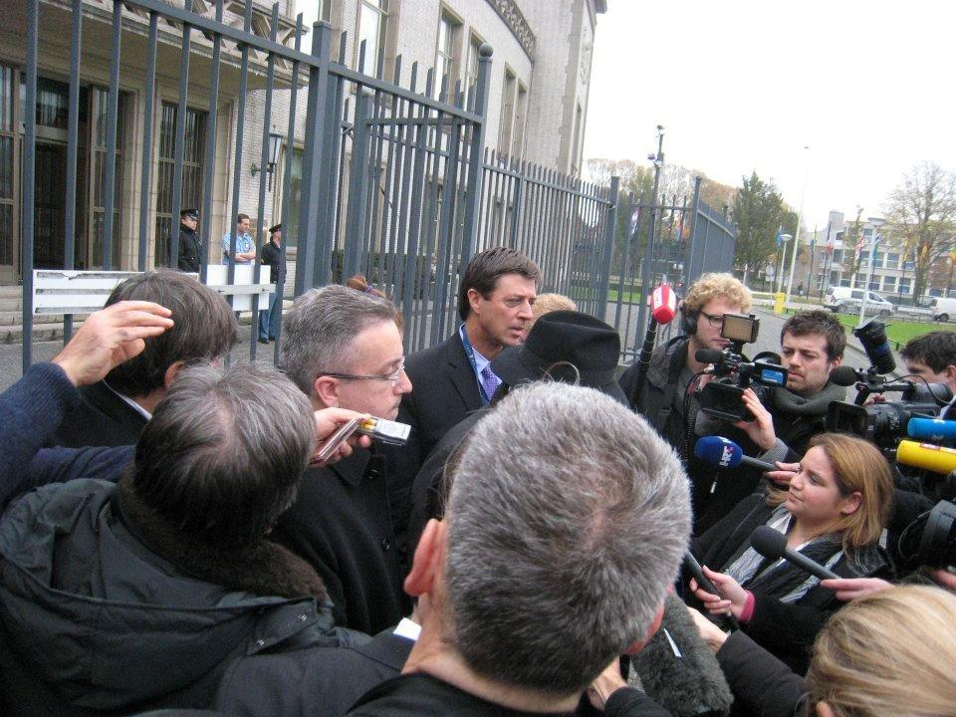
HEADING TO ZAGREB AFTER THE APPEAL

