Slide 1
IMELUM
Your Source of Context in South East Europe
EU Funds Webinar
The impact of EU structural funds on the economy
Zagreb, 15 February, 2021

Slide 2
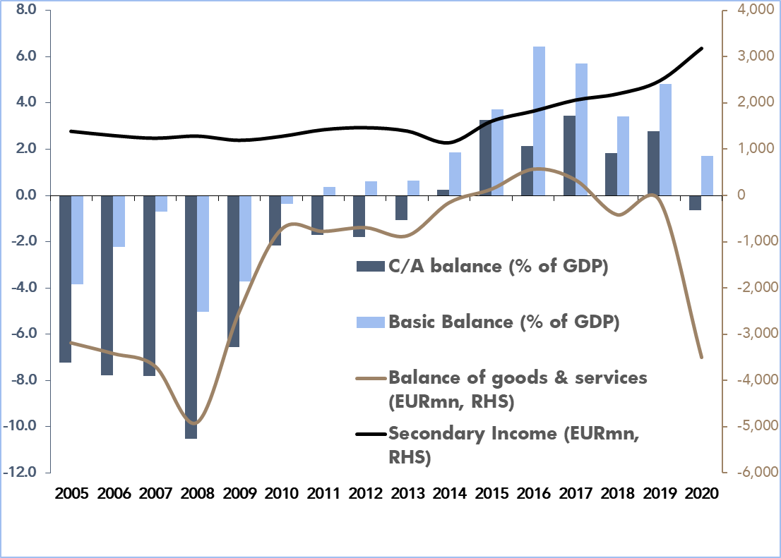
Current account deficit swings into surplus…
Source: HNB, IMELUM

Slide 3
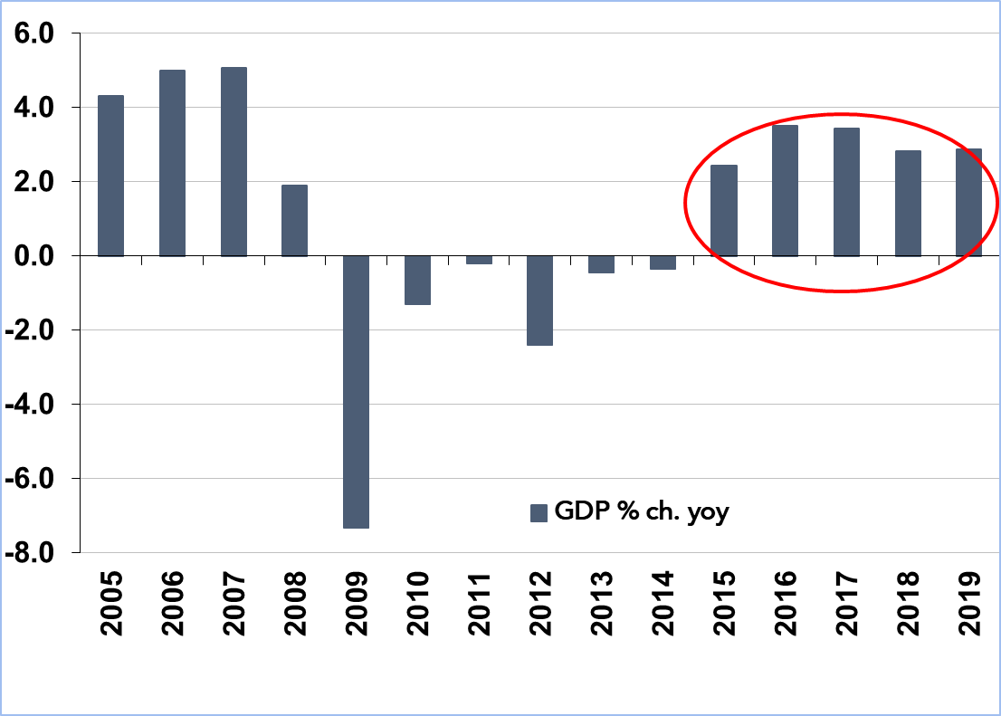
…supporting GDP growth and…
Source: DZS, IMELUM

Slide 4
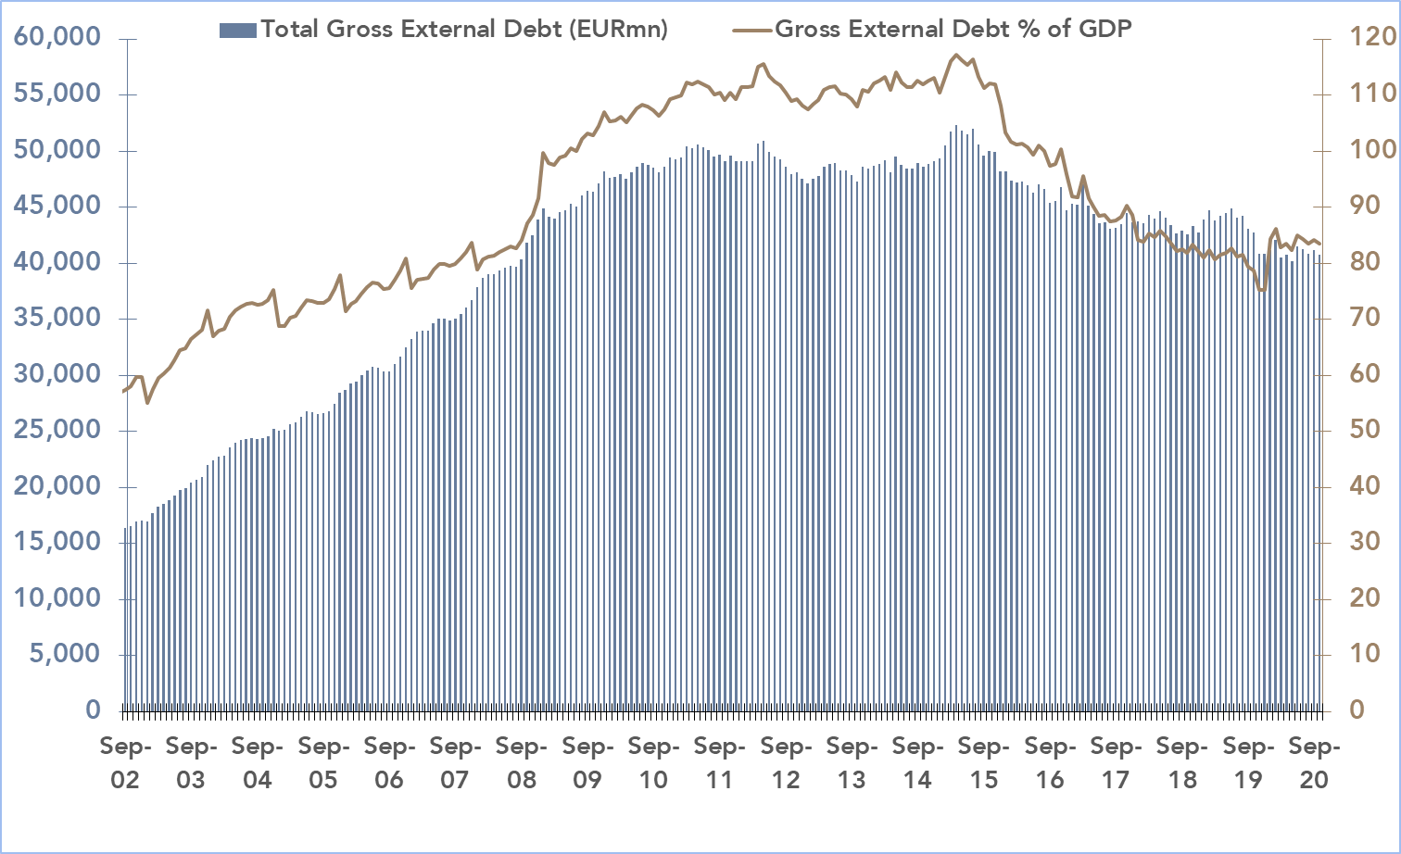
…leading to a fall in external debt
Source: HNB, IMELUM

Slide 5
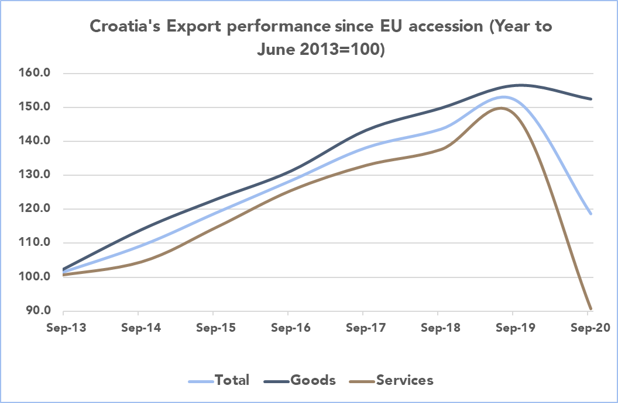
Exports of goods have risen sharply since EU accession and fell only marginally in 2020
Source: DZS, IMELUM

Slide 6
Disclaimer
Prepared by: Goran Šaravanja
Contact: goran.saravanja@imelum.com
The information and material contained in this Presentation, including text and graphics, is verified to the best of the author’s ability. It is intended for general guidance and information purposes and therefore, Imelum d.o.o. does not accept responsibility for any loss from reliance on it.

Slide 7
The future of EU funds in the Republic of Croatia
EU Services, PwC Croatia
Zagreb, 25 February 2021.

Slide 8
EU Services – Private & Public sector
The most appropriate funding resource is identified, which match the company’s organisation’s needs with the EU funding opportunities.
In this stage we help organizations in the process of idea conceptualisation, formulation and development, considering the company’s/organisation’s resources as well as its future targets, objectives and priorities.
Preparing investment studies, business plans, application forms etc. Collecting all necessary documentation for the application, management of project partners (if there are any), project budget formulation and aligning the project proposal with European strategies and policies.
Identifying source of
funding / financing
Proposal preparation
and application
submission
Policy analysis
and advisory
Project implementation
and management
Impact assessment, policy monitoring and evaluation (ex-ante, mid-term, ex-post) as well as regulatory fitness checks, policy design and analysis (covering all aspects of economic and financial analysis) and policy development, delivering policy, feasibility and pan-European studies. Design and implementation of EU programmes and how to set up financial instruments focused for example on energy efficiency, urban and territorial development and social inclusion.
Public procurement
Financial and administrative management of the project, progress monitoring and reporting and results dissemination.
Advising the private and public sector in preparing and implementing public procurement process. Sharing public procurement best practices, identifying and protecting procurement against corruption.

Slide 9
Our team
PwC works as one integrated team that provides services to our clients in private and public sector, working hand in hand with our local experts.
We have a dedicated team of highly specialized experts working across different sectors. Over the past 5 years, we have supported our clients through successful completions of major projects in the tourism, finance, infrastructure and energy sectors.
We have helped our public and private clients develop and finance from EU and national funds a number of ground breaking projects in tourism and manufacturing sectors, the energy and renewable sectors, etc. In collaboration with our external offices, our EU Services team has participated in various feasibility studies, market research, strategies development etc.
We work extensively with EU institutions, the EIB, the EBRD and others as well as government of Republic of Croatia.

Slide 10
Review of EU budget packages
European Public Administration
€ 73.1 billion
Single Market, Innovation and Digital
€ 1,099.6 billion
Neighborhood and the World
€ 98.4 billion
Security and Defense
€ 13.1 billion
The European Union has responded to the crisis caused by the COVID-19 pandemic with an ambitious aid package to Member States, opening a new chapter in European cohesion.
In addition to the adoption of the Multiannual Financial Framework for the period from 2021 to 2027, the EU has also adopted a special package of assistance to the Member States – Next Generation EU.
Migration and Border Management
€ 22.6 billion
NEXT GENERATION EU
Natural Resources and
The Environment
€ 373.8 billion
Cohesion, Resilience and Values
€ 1,099.6 billion

Slide 11
For the first time in the history of the European Union, we manage and use as many as three EU budget packages at the same time.
The Republic of Croatia has at its disposal a total allocation of 24.2 billion euros, which is more than twice the amount we received for the period from 2014 to 2020.
Review of EU budget packages
10.73
billion euros
The absorption of the allocation from the previous multiannual financial framework depends on the implementation of projects by the end of 2023 (the so-called N+3 rule).
14.3
billion euros
In the new perspective, new operational programs based on the highest EU priorities await us, the implementation of which will last until 2030.
Multiannual financial framework 2014 – 2020
Multiannual financial framework 2021 – 2027
2020
2021
2022
2023
2024
2025
2026
2027
2028
2029
2030
Next Generation EU
9.9
billion euros
From the Next Generation EU aid packages, almost 10 billion euros have been directly allocated to Croatia, with the potential to withdraw additional funds.
The centerpiece of this assistance package is the Recovery and Resilience Facility, which provides € 672.5 billion, of which € 312.5 billion will be allocated in the form of grants for investment and reforms. The funds of this mechanism will be used based on the priorities defined in the national recovery and resilience plans

Slide 12
Multiannual financial framework 2014 – 2020
Decided
Contracted
Spent
Certified
Total available grant amount for the Republic of Croatia in the period from 2014 to 2020
Total value of signed Grant Agreements with beneficiaries
Grant payments to beneficiaries based on the approval of eligible expenditures incurred in the implementation of projects.
Total amount of approved and eligible expenditure declared to the European Commission (Certification of Statement of expenditure)
100%
113,40%
47,16%
40,89%
10.73
billion euros
12.17
billion euros
5.06
billion euros
4.39
billion euros
* Data source: Ministry of Regional Development and EU Funds, 42nd Session of the Government of the Republic of Croatia, 4 February 2021
ANNOUNCEMENT: Call for proposals for the building and equipping production facilities of companies worth between 1 billion and 1.5 billion HRK for entrepreneurs in all sectors. It is expected in the first half of 2021.
REACT-EU (Recovery Assistance for Cohesion and the Territories of Europe): funds that strengthen the allocations of funds for the period from 2014 to 2020 in order to bridge the period until the use of new funds.

Slide 13
Progress of the Republic of Croatia in the programming of EU funds
National Recovery and Resilience Plan
Partnership agreement (ESI funds)
National Development Strategy
What are our clients and potential clients currently doing?
They try to ensure that their planned projects are included either directly or according to the scheme in some of the program documents.
What are the institutions currently trying in the strategic planning system?
Gather enough projects that are ready to implement and contribute to the green and digital transition.
37% of the costs must contribute to the green transition
20% of the cost must contribute to the digital transition
The deadline for submitting the plan to the European Commission is April 30, 2021
Adoption of the plan by the European Commission is a prerequisite for the payment of a 20% advance
OP Competitiveness and Cohesion 2021 – 2027
OP Efficient Human Resources 2021-2027
European Territorial Cooperation Programme 2021-2027
CAP Strategic Plans 2021-2027
For the period from 2021 to 2027, the Republic of Croatia will develop 78 umbrella, sectoral and multisectoral acts of strategic planning, with all acts of strategic planning at the level of LRU (R) Sa.
All strategic acts must be harmonized with the National Development Strategy 2030.

Slide 14
Progress of the Republic of Croatia in the programming of EU funds
National Coordination Committee for ESI Funds in the Republic of Croatia:
Working Group
„Smart Croatia”
Coordination of the preparation of programming documents for the period from 2021 to 2027 is underway and it is expected that the first drafts will be prepared in June 2021.
A public consultation process for the Partnership Agreement and for the operational programs is planned for September 2021.
The new law defining the institutional framework for the use of EU funds from 2021 to 2027, according to the plan, should be adopted in June 2021, and supplemented by bylaws successively by June 2022.
Working Group „Green Croatia”
Working Group „Connected Croatia”
Working Group „Solidarity Croatia”
Working Group
„Croatia closer to the citizens”
Working Group
"Safe Croatia"
Working Group „Maritime and fisheries”

Slide 15
Financing instruments
Regional policy
Cohesion Fund
European Regional Development Fund
European Structural and Investment Funds
Croatian Bank for Reconstruction and Development
1
EIB
2
European Social Fund
EU funding programs
3
Maritime and Fisheries Fund
Text to go here to go here to go here to go here to go here to
Agricultural
Fund for Rural Development
Notes:
The purpose of all these funds is to invest in job creation and a sustainable and healthy European economy and environment. Over half of EU funding is channelled through the 5 European structural and investment funds (ESIF). They are jointly managed by the European Commission and the EU countries.
The Cohesion Fund is aimed at Member States whose Gross National Income (GNI) per inhabitant is less than 90 % of the EU average. It aims to reduce economic and social disparities and to promote sustainable development.
The ERDF aims to strengthen economic and social cohesion in the European Union by correcting imbalances between its regions and it focuses its investments on several key priority areas. This is known as 'thematic concentration’:
Innovation and research; - The digital agenda; - Support for small and medium-sized enterprises (SMEs); The low-carbon economy.
Also the financial instruments t
The ESF is Europe’s main tool for promoting employment and social inclusion – helping people get a job (or a better job), integrating disadvantaged people into society and ensuring fairer life opportunities for all.
The EMFF is the fund for the EU's maritime and fisheries policies. It helps fishermen in the transition to sustainable fishing; supports coastal communities in diversifying their economies; finances projects that create new jobs and improve quality of life along European coasts and supports sustainable aquaculture developments.
EAFRD) is the funding instrument that supports rural development strategies and projects. Some of the priorities are fostering knowledge transfer and innovation in agriculture, forestry and rural areas; enhancing the viability and competitiveness of all types of agriculture, and promoting innovative farm technologies and sustainable forest management; restoring, preserving and enhancing ecosystems related to agriculture and forestry; promoting social inclusion, poverty reduction and economic development in rural areas.

Slide 16
Institutional framework of the Republic of Croatia
Ministry of Regional Development and EU Funds (Coordinating Body)
Ministry of Regional Development
and EU Funds (Government body –
OP Competitiveness and cohesion)
Ministry of Regional Development
and EU Funds (Government body –
OP Competitiveness and cohesion)
Ministry of Agriculture (Government body – Rural Development Program,
OP Maritime Affairs and Fisheries)
Level 1
Intermediate Bodies:
- Ministry of Economy and Sustainable Development
- Ministry of Physical Planning, Construction and State Assets, ..
Level 2
Intermediate Bodies:
- Central Finance and Contracting Agency
- Croatian Agency for SMEs, Innovations and Investments
- Environmental Protection and Energy Efficiency Fund
Level 1
Intermediate Bodies:
- Ministry of Labour, Pension System, Family and Social Policy
- Ministry of Tourism and Sport
-Office for Cooperation with NGOs
- ...
Level 2
Intermediate Bodies:
- Croatian Employment Service
- National Foundation for Civil Society Development
Level 1
Intermediate Bodies:
- Paying Agency for Agriculture, Fisheries and Rural Development (PAAFRD)
Notes:
Operational programs

Slide 17
Disbursement of EU funds from 2007 to 2020
For the period 2014. – 2020., Croatia has 10.7 billion euro from the EU funds at its disposal and expects 24,2 billion euro in the next seven year budget (2021. – 2027.)
IPA Instrument for pre-accession assistance
ESIF European structural and investment funds

Slide 18
Basic Information about the Call for the proposal
Announcement of the Call for proposals: Release date is 15. February, 2021 (preceded by open e-counseling procedure)
Call for the proposal type:
Temporary / Permanent Call Mode ("fastest finger" vs. quality assessment)
The deadline for submitting applications:
Deadline for submitting project proposals is 15. May, 2021.
Notes:
Guidelines for applicants
This is something you should check at the start

Slide 19
Aim/Purpose of the Call for the proposal
Objective for the energy efficiency Call: Support the implementation of energy efficiency measures and / or measures for use renewable energy sources that will be the energy cost of the enterprise registered for carrying out tourism and / or trade activities reduced consumption of delivering energy by at least 20% compared to the reference energy delivered or the consumption delivered energy before the implementation of measures.
Objective for the improving production capacities Call:
Strengthening the regional competitiveness of SME’s through the development of identified strategic activities of the industry. Encouraging value-added activities and effectively positioning SMEs in global value chains will enable the development of new competencies, increase production, increase exports and create new jobs.
Objective for the R&D Call:
Development of new products (goods and services), technologies and business processes through increasing private investment in research, development and innovation, and strengthening the capacity of companies for research, development and innovation, through improving their cooperation with research and development institutions.
Notes:
Every Call for proposal has his specific guidelines and objectives. For this purpose we singled out three calls for different purposes – 1. one is the call that is financing green transition – projects that are investing in energy efficiency and renewable sources of energy (like solar plant or something like that). 2. one is for the improving

Slide 20
Eligible applicants and partners
Energy efficiency Call eligible applicants:
Legal or natural persons, registered in Croatia, who are micro, small, medium or large size enterprises according to Regulation EC 651/2014 in a production or service sector (excluding military industry, agriculture, fisheries and aquaculture)
Improving production capacities Call eligible applicants:
Legal or natural persons, registered in Croatia, who are micro, small or medium size enterprises according to Regulation EC 651/2014 in a production or service sector (excluding military industry, agriculture, fisheries and aquaculture)
R&D Call eligible applicants and partners:
Legal or natural persons, registered in Croatia, who are micro, small, medium or large size enterprises according to Regulation EC 651/2014 in a production or service sector (excluding military industry, agriculture, fisheries and aquaculture)
entrepreneurs and/or research and dissemination organizations that contribute their knowledge, resources and research capacities to the implementation of research and development projects. Also, partners are those who do not have a registered office, business unit or branch in the Republic of Croatia, and participate in the project with a maximum of 15% of eligible project costs

Slide 21
Indicators of the Call for the proposal
Indicator for the energy efficiency Call:
The share of renewable energy in gross final energy consumption in the production / service sector
Energy saving in the production / service sector measures
Indicator for the improving production capacities Call:
Increased sales revenue
Increased export earnings
Employment growth
Indicator for the R&D Call:
Increase of patent applications, trademarks and industrial design of companies participating in the project
Sale of innovations that are new on the market (new-to-market) and innovations that are new in companies (new-to-firm) as % of turnover
Notes:
Objective for the energy efficiency Call:
The share of renewable energy in gross final energy consumption in the production / service sector; measures increasing the amount of energy produced from renewable energy sources before and after energy recovery.
Energy saving in the production / service sector measures; the difference between the amount of delivered energy before the implementation of the project proposal activity and after the implementation of the project proposal activity
Objective for the improving production capacities Call:
Increased sales revenue Sales revenue of an enterprise is the revenue of an enterprise from operating activities arising from the sale of goods and services over a period of time.
Increased export earnings; The company's export earnings represent the value of production and / or services provided from sales abroad (including EU countries).
Employment growth; Gross new jobs in enterprises that received full-time equivalent (FTE) support, which also recorded part of the increase in employment as a direct result of project completion.

Slide 22
Acceptable activities
Energy
1.
2.
3.
Preparation of project proposal documentation and other project technical documentation
Implementation activities
Project management and administration, promotion and visibility activities
Buying new equipment and machinery
Bulding or restorating the production facilities,
Renovation of technical systems for the use of energy-cost unit buildings,
Research and development – staff costs, etc.
Preparation of application forms and other project proposal documentation
Preparation of documentation for the procurement of goods, provision of services and works,
Making other project technical documentation
Project management
Administration and technical coordination
Financial management, reporting
Supervision of work execution and commissioning, etc.
Notes:
The applicant is obliged to submit a budget of all eligible costs for the implementation of the project, while the total amount due to the source of the funds is due to the unacceptable costs.
Eligible and unacceptable costs are the total value of the project.
The amount of co-financing applies only to eligible project costs.

Slide 23
Financial allocation and amount of support
Energy efficiency Call:
Maximum possible amount of grant awarded per project is around 2,7 milion euro with co-financing rate from 45 up to 85% of accepted costs
Improving production capacities Call:
Maximum possible amount of grant awarded per project is around 2 milion euro with co-financing rate from 45 up to 75% of accepted costs
R&D Call:
Maximum possible amount of grant awarded per project is around 3 milion euro with co-financing rate from 25 up to 85% of accepted costs

Slide 24
Content of the project proposal
The project proposal should be completed and submitted through the eFunds system and contain the following documents in the required format and order:
Application form
Investment study / Business plan
Applicant's statement
Infrastructure component of the project (e.g. permits, architectural / construction project)
Statement on received state aid
Financial construction (e.g. letter of intention from the bank)
Additional documentation (e.g. no debt tax administration certificate, excerpt from the court register, Annual Financial Report)

Slide 25
EU project workflow
Analysis
1 month
Eligibility of applicants, project and planned activities
Governance and Ownership Structure
Entrepreneurial test in difficulty
Implementation
12 to 24 months
Project Management
Preparation and implementation of procurement procedures
Communication with implementing bodies
End of a project
1 to 2 months
Financial audit of the project
Final control of implementing bodies
Preparing the project
Proposal
1 to 3 months
Application Forms, Business plan/Investment study, Extract from Court Register, Commission review, and submission of project proposal through the eFunds system
Signature of the
Grant Agreement
1 to 2 months
General contract terms
Special terms of contract
Implementation package of documentation
Post project activities
5 years
Reporting and maintaining the results of the project
Evaluation of the
project proposal
4 to 6 months
Project Selection Committee (MESD)
Decision of selection (MEEC)
Eventual objections (MRDEUF)
Notes:
MESD - Ministry of Economy and Sustainable Development
MRDEUF - Ministry of Regional Development and EU Funds

Slide 26
Thank you for your attention!
Contacts:
Niko Letilović
EU Services | Manager
+385 99 245 9150 niko.letilovic@pwc.com
Neven Habunek
EU Services | Manager | PS&I Operations Leader
+385 99 375 9827 neven.habunek@pwc.com
© 2020 PricewaterhouseCoopers Advisory Ltd. All rights reserved. PwC refers to the Croatian member firm, and may sometimes refer to the PwC network. Each member firm is a separate legal entity. At PwC Croatia, our purpose is to build trust in society and solve important problems. We’re a network of firms in 155 countries with more than 284,000 people who are committed to delivering quality in assurance, advisory and tax services. Find out more and tell us what matters to you by visiting us at www.pwc.hr.

